Slide 1
Python 3.0
By
Megha Xavier

Slide 2
WHAT IS THE FIRST THING COMES TO YOUR MIND WHEN YOU HEAR THE WORD “PYTHON”?
Is IT THE FEROCIOUS SNAKE ?
OR
AN INTERESTING PROGRAMMING LANGUAGE?

Slide 3
Introduction to Python
What is python?
Python is a widely used general purpose high level programming language.

Slide 4
What can Python do?
Python can be used on a server to create web applications.
Python can connect to database systems. It can also read and modify files.
Python can be used to handle big data and perform complex mathematics.

Slide 5
History of Python
Guido Van Rossum is the one who gave the idea of python in the year 1980.
The implementation started in 1989.
Python was published in 1991.
Python 1.0 released in 1994.
Python 2.0released in 2000.
Python 3.0released in 2008.
Python 3.7.4 is the latest release 2017.

Slide 6
Why Python?
Python works on different platforms (Windows, Mac, Linux, Raspberry Pi, etc).
Python has a simple syntax similar to the English language.
Python has syntax that allows developers to write programs with fewer lines than some other programming languages.
Python runs on an interpreter system, meaning that code can be executed as soon as it is written.
Python can be treated in a procedural way, an object-oriented way or a functional way.

Slide 7
Python Syntax compared to other programming languages
Python was designed for readability, and has some similarities to the English language with influence from mathematics.
Python uses new lines to complete a command, as opposed to other programming languages which often use semicolons or parentheses.
Python relies on indentation, using whitespace, to define scope; such as the scope of loops, functions and classes. Other programming languages often use curly-brackets for this purpose.

Slide 8
FEATURES
Simple
Easy to learn
Easy to maintain
Interpreted
Object oriented concept
Interactive mode
Extendable
Portable
Garbage collection

Slide 9
WHO CAN LEARN?
No specification needed
Language for the beginners
A language that is used in software development,web development,electronics and networking

Slide 10
Installing Python
Python for Win/Mac/Unix/Linux is available from www.python.org.

Slide 11
IDLE Development Environment
IDLE is an Integrated Development Environment for Python, typically used on Windows
Multi-window text editor with syntax highlighting, auto-completion, smart indent and other.
Python shell with syntax highlighting.

Slide 12
Shell Window
Line by line execution
Errors cannot be cleared
Programs cannot saved
Eg:-
>>>print(“Hello Python”)

Slide 13
Script Window
Used to store lengthy programs
Errors can be cleared
Outputs are obtained in shell window
Eg:-
print(“Hello Python”)

Slide 14
Python Comments
Comments can be used to explain Python code.
Comments can be used to make the code more readable.
Creating a Comment
Comments starts with a #

Slide 15
variables
Variables are containers for storing data values.
Creating Variables
Python has no command for declaring a variable.
A variable is created the moment you first assign a value to it.
x = 5 y = "John" print(x) print(y)

Slide 16
money=200
print(money)
money=500
print(money)
cash=money
print(cash)
money=‘abc’
print(money)
2o+10+365
3*52
3670-156
20+10*365-3*52
a=20
b=10
year=365
c=3
a+b*year-c*52

Slide 17
Casting
x = str(3) # x will be '3' y = int(3) # y will be 3 z = float(3) # z will be 3.0
Get the Type
x = 5 y = "John" print(type(x)) print(type(y))
get the data type of a variable with the type() function.

Slide 18
Single or Double Quotes
x = “Job" # is the same as x = ‘Alex‘
Case-Sensitive
a = 4
A = “Ram“
#A will not overwrite a
print(a)
print(A)

Slide 19
Variable Names
A variable name must start with a letter or the underscore character
A variable name cannot start with a number
A variable name can only contain alpha-numeric characters and underscores (A-z, 0-9, and _ )
Variable names are case-sensitive (age, Age and AGE are three different variables)
myvar = “Ram" my_var = “Ram" _my_var = “Ram" myVar = “Ram" MYVAR = “Ram" myvar2 = “Ram"

Slide 20
Many Values to Multiple Variables
x, y, z = "Orange", "Banana", "Cherry"
print(x)
print(y)
print(z)

Slide 21
One Value to Multiple Variables
x = y = z = "Orange" print(x) print(y) print(z)

Slide 22
Operators in python
Arithmetic operators
Bitwise operators
Logical operators
Membership operators
Identity operators

Slide 23
Arithmetic operator
+
-
*
/
%
**
//

Slide 24
1+1
5*5
2*10
5/2
5-5
1.0+1.5
5*2.5
25/.25
1/2
1//2
5/2
5//2
100/7
100//7

Slide 25
10%3
100%7
2+5*2
(2+5)*2
((5+30)*20)/5
((5+30)*20)//5
-2+5
-5+-5
2*3
2**3
5**5

Slide 26
Bitwise operator
Used to handle binary numbers (0,1)
|- bitwise OR
& - bitwise AND
^ - bitwise XOR – both are true/false – false
otherwise – true
~ - compliment – true – false
false – true
<< - left shift – shift the number of bits towards left
>> - right shift – shift the number of bits towards the right

Slide 27
Membership operator
in – variable in sequence
not in – variable not in sequence

Slide 28
Identity operator
is – if two variables reference to same object – true
Otherwise – false
Eg – a=5
b=6
a is b - false
is not – if two variables not reference to the same object – true
otherwise – false
Eg –
a=5
b=6
a is not b - true

Slide 29
Logical operators
Logical AND - &&
Logical OR - ||
Logical NOT - !

Slide 30
Standard Data types in Python
Numbers
Strings
List
Tuple
Dictionary

Slide 31
Numbers
Int
Long
Float
Complex
Type conversion
X=3
Type(x)

Slide 32
Strings
Immutable - It means they cannot be changed after they created.
Sequence of characters
Strings can be represented within (‘ ‘, “ “ , “’ ‘’’) eg:(“abc”)
Operators in string
Concatenation(+)
Repetation(*)

Slide 33
Indexing and Slicing
Indexing – To access an individual character from a string.
Indexing always starts with zero.
Slicing – To access range of a characters from
a string.

Slide 34
String functions
Len(Str)
Str=“networkz”
len(Str)
Str.lower()
Str.upper()
Str.capitalize()
Str.startswith(‘a’)
Str.endswith(‘a’)
Str.count(‘a’)
Str.strip()
Str.isdigit()
Str.isalpha()
Str.isalnum()
Str.space()
Word.replace(“hello”,”goodbye”)

Slide 35
Lists
Mutable
List=[1,2,3,4]
List are collection of items
List use square brackets
Operations include indexing,slicing,concatenation,repetition and checking for membership

Slide 36
Print(“hello”)
basket=‘ apple, grape, orange, dates’
print(basket)
We use list
basket=[‘apple’,’grapes’,’orange’,’dates’]
print(basket)
print(basket[3])
basket[3]=‘banana’
print(basket[1:5])
numbers=[1,2,3,4,4]
print(numbers)
numbers=[1,2,3,4,4,’America’,’japan’]
print(numbers)
mainlist=[basket,numbers]
Print(mainlist)

Slide 37
basket=[‘apple’,’grapes’,’orange’,’dates’,’jackfruit’,’watermelon’]
print(basket)
basket[3]=‘banana’
basket.append(‘cherry’)
basket.append(‘plum’)
basket.append(‘papaya’)
print(basket)
del basket[6]
del basket[4]
del basket[2]
print(basket)
List1=[1,2,3,4,4]
List2=[‘car’,’bus’,’jeep’,’auto’]
listbig=list1+list2
print(listbig)
mylist[‘x’,’y’]
print(mylist*5)
Kamala=[‘1’,’2’]+[‘3’,’4’]
print(kamala)
Thulasi=10*[‘hi’]
print(thulasi)

Slide 38
Date Program

Slide 39
in operator
name=‘Barak Obama’
print(‘o’ in name)
print(‘e’ in name)
print(‘ar’ in name)
print(‘er’ in name)
name=‘Barak Obama is the president of united states’
print(‘president’ in name)
List1=[‘india’,’china’,’japan’]
print(‘india’ in list)

Slide 40
program
Username=input(“username:”)
Password=input(“password:”)
Database=[
[‘megha’,’1234’],
[‘Anu’,’5678’]
[‘Aishu’,’1256’]
]
If [username,password] in database:
print(“login successful”)

Slide 41
methods
len()
max()
min()
list[‘hello’]
list.append()
count()
extend()
insert(arg1,arg2)
pop()
remove()
reverse()
sort()

Slide 42
Tuple
Immutable
Tuples are sequences just like lists
Tuples use parenthesis
t1=(1,2,3,4)
Tuple operations include indexing,slicing,concatenation,repetition,membership
Updations not possible

Slide 43
Dictionary
Mutable
Unordered collection of items
It contains key:value
d1={‘id’:101,’name’:’networkz’}
Keys are unique but values are may not be
Duplication not possible
Concatenation(update)

Slide 44
Creating a dictionary
Dictionary_name={}
Dictionary_name={‘ram’:10,’raju’:20,’seetha’:30}
Printing a dictionary
dictionary_name={‘ram’:10,’raju’:20,’seetha’:30}
Print(dictionary_name)
Get the values in a dictionary
dictionary_name={‘ram’:10,’raju’:20,’seethe’:30}
Print(dictionary_name[‘raju’])

Slide 45
Get all keys from dictionary
dictionary_name={‘ram’:10,’raju’:20,’seetha’:30}
print(dictionary_name.keys())
Get items from dictionary
dictionary_name={‘ram’:10,’raju’:20,’seetha’:30}
print(dictionary_name.items()) //list of tuples

Slide 46
Add elements to a dictionary
dictionary_name={}
dictionary_name[‘ram’]=10
dictionary_name[‘raju’]=20
Print(dictionary_name)
Delete elements of a dictionary
dictionary_name={‘ram’:10,’raju’:20,’seetha’:30}
del dictionary_name[‘raju’]
Print(dictionary_name)

Slide 47
Range()
range(0,10)
range(10)
list(range(10))
List(range(0,20,3))
List(range(0,-10,-1))
a=50
list(range(a))

Slide 48
Python Conditions and If statements
Python supports the usual logical conditions from mathematics:
Equals: a == b
Not Equals: a != b
Less than: a < b
Less than or equal to: a <= b
Greater than: a > b
Greater than or equal to: a >= b

Slide 49
example
a = 33 b =100
if b > a: print(“b is greaterthan a”
age=10
If age==10:
print(“he is 10”)

Slide 50
Elif
The elif keyword is pythons way of saying "if the previous conditions were not true,
a=33 b =33
if b > a:
print("b is greater than a")
elif: a == b:
print("a and b are equal")
If age==15:
print(“he is 15”)
else:
print(“he is not 15”)
Age=10
If age>5:
print(“he is above 5”)
else:
print(“he is a small boy”)

Slide 51
Else
a =200 b =33
if b > a:
print("b is greater than a")
elif: a == b:
print("a and b are equal")
else:
print("a is greater than b")
If age==15:
print(“he is 15”)
else:
print(“he is not 15”)
Age=10
If age>5:
print(“he is above 5”)
else:
print(“he is a small boy”)

Slide 52
age=10
If age==13:
print(“he is 13”)
elif age==12:
print(“he is 12”)
elif age==11:
print(“he is 11”)
elif age==10:
print(“he is 10”)
else:
print(“he is a small boy”)

Slide 53
And
The and keyword is a logical operator, and is used to combine conditional statements
a = 200 b = 33 c = 500 if a > b and c > a: print("Both conditions are True")

Slide 54
Or
a = 200 b = 33 c = 500 if a > b or a > c: print("At least one of the conditions is True")

Slide 55
name=‘ammu’
If name==‘ammu’ or name==‘appu’:
print(“come home”)
else:
print(“sorry.u have no permission”)
age=‘10’
If age==10: // <=, <5, >=, >5, !=, if age is 10, if age is not 10
print(“u r right”)
print(“The statement is true”)
else:
print(“the statement is false”)

Slide 56
pass
a = 33 b = 200 if b > a: pass

Slide 57
Python Loops
while loops
for loops

Slide 58
For loop
Syntax
for iterating_var in sequence:
stmts(s)
print(“hello”)
for i in range(5):
print(“hello”)
for letter in ‘nation’:
print(letter)

Slide 59
my_list=[‘one’,’two’,’three’,’four’,’five’]
for i in my_list:
print(i)
for obj in my_list:
print(obj,len(obj))
my_list[2]
for index in range(5):
print(index,my_list[index])
for index in range(0,5,2):
print(index,my_list[index])
a=[‘a’,’b’,’c’]
b=[1,2,3]
for i in a:
print(i)
for j in b:
print(j)

Slide 60
while Loop
i = 1 while i < 6: print(i) i += 1

Slide 61
break
break statement we can stop the loop even if the while condition is true
i =1
while i <6:
print(i) if i == 3: break i += 1

Slide 62
continue
continue statement we can stop the current iteration, and continue with the next
i = 0 while i < 6: i += 1 if i == 3: continue print(i)

Slide 63
For loop
Syntax
for iterating_var in sequence:
stmts(s)
print(“hello”)
for i in range(5):
print(“hello”)
for letter in ‘nation’:
print(letter)

Slide 64
my_list=[‘one’,’two’,’three’,’four’,’five’]
for i in my_list:
print(i)
for obj in my_list:
print(obj,len(obj))
my_list[2]
for index in range(5):
print(index,my_list[index])
for index in range(0,5,2):
print(index,my_list[index])
a=[‘a’,’b’,’c’]
b=[1,2,3]
for i in a:
print(i)
for j in b:
print(j)

Slide 65
While loop
While True:
print(“hello”)

Slide 66
FUNCTIONS
Reusability
Reuse the function in many of programs
Easy debugging
Function declaration,function call,function definition

Slide 67
Function Definition
Every function should start with “def” keyword.
Every function should have name(not equal to any keyword)
Parameters/Arguments(optional)
Every function name with /without arguments should end with(:)
Return – empty/value(return multiple value to the calling function)
Multivalue return can be done(tuple)

Slide 68
Function call
Function name
Arguments/parameters

Slide 69
Function example
def testfunction(myname):
print(“hello %s”% myname)
>>>testfunction (‘ networkz ’)
def testfunction(firstname,lastname):
print(“Hello %s %s”%(firstname,lastname))
def testfunction(income,expense):
return income-expense
>>>testfunction(10000,5000)

Slide 70
program
/* function to add two numbers */
def add(a,b):
sum=a+b
return sum
a=int(input(“Enter the first number”))
b=int(input(“Enter the second number”))
res=add(a,b)
Print(“Result”,res)

Slide 71
Global and local variable
Scope
Local – with in the function where variable have been declared
global – entire program

Slide 72
Variables and scope
outside_var=500
def function():
outside_var+inside_var
inside_var=10
def anotherfunction():
outside_var
anotherinside_var=50

Slide 73
sugar=100
milk=1
def make_apple_juice():
apple=5
juice=apple+sugar+milk
print(“juice is ready”)
def make_tea():
tea_powder=1
tea=tea_powder+sugar+milk
print(“tea is ready”)
>>>make_apple_juice()
>>>make_tea()
>>>print(sugar)
>>>print(milk)
>>>print(apple)--→error
>>>print(tea_powder)-→error

Slide 74
Excercise
1. Write a Python function to find the Max of three numbers.
2. Write a Python function to sum all the numbers in a list.
Sample List : (8, 2, 3, 0, 7) Expected Output : 20
3.Write a Python function to multiply all the numbers in a list. Sample List : (8, 2, 3, -1, 7) Expected Output : -336
4. Write a Python program to reverse a string. Sample String : "1234abcd" Expected Output : "dcba4321“
5.Write a Python function to check whether a number is in a given range.
6. Write a Python function that accepts a string and calculate the number of upper case letters and lower case letters. Sample String : 'The quick Brow Fox’ Expected Output : No. of Upper case characters : 3 No. of Lower case Characters : 12

Slide 75
Object Oriented Programming
One of the popular approaches to solve a programming problem is by creating objects. This is known as Object-Oriented Programming (OOP).
An object has two characteristics:
attributes
Behavior
Ex-
A parrot is can be an object,as it has the following properties:
name, age, color as attributes
singing, dancing as behavior

Slide 76
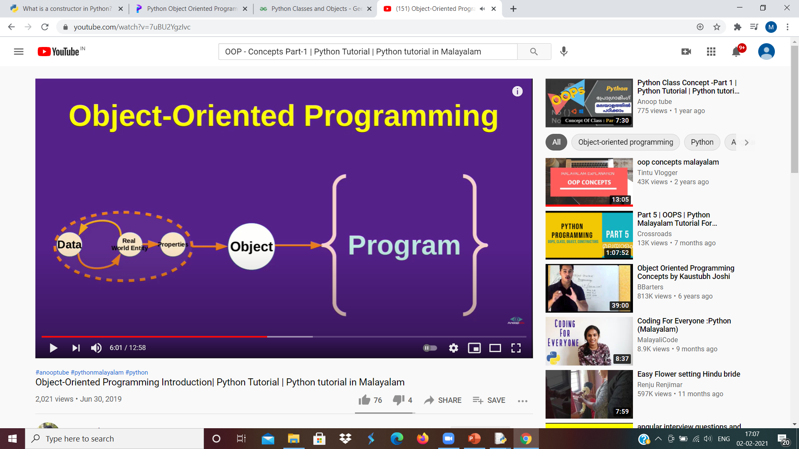
Object Oriented Programming

Slide 77
class
Every class can have multiple instances(object)
Logical structure with behaviour
Class can have attributes and function
class Parrot:
pass
object
Object is instance of a class
An object (instance) is an instantiation of a class. When class is defined, only the description for the object is defined. Therefore, no memory or storage is allocated.
obj = Parrot()
Here, obj is an object of class Parrot

Slide 78
Class and object
.
class Sample:
print(“this is a class”)
s=Sample()
print(s)
__init__() Function
All classes have a function called __init__(), which is always executed when the class is being initiated.
Use the __init__() function to assign values to object properties, or other operations that are necessary to do when the object is being created.

Slide 79
Class Sample:
def __init__():
print(“this is a class”)
class Sample:
def __init__():
print(“this is a class”)
s=Sample()

Slide 80
Sample program
class Sample:
text="hello world"
def __init__(self):
print("this is a class")
def sample_method(self):
print("value of text:",self.text)
s=Sample()
s.sample_method()
s.text="updated value"
s.sample_method()

Slide 81
Constructor(default)
class rect:
def __init__(self):
self.l=5
self.b=6
def area(self):
return self.l*self.b
r=rect()
print(r.area())
print(r.__init__())

Slide 82
Parameterised constructor
class rect:
def __init__(self,x,y):
self.l=x
self.b=y
def area(self):
return self.l*self.b
a=int(input(“Enter the length”))
b=int(input(“Enter the breadth”))
r=rect(a,b)
Print(r.area())

Slide 83
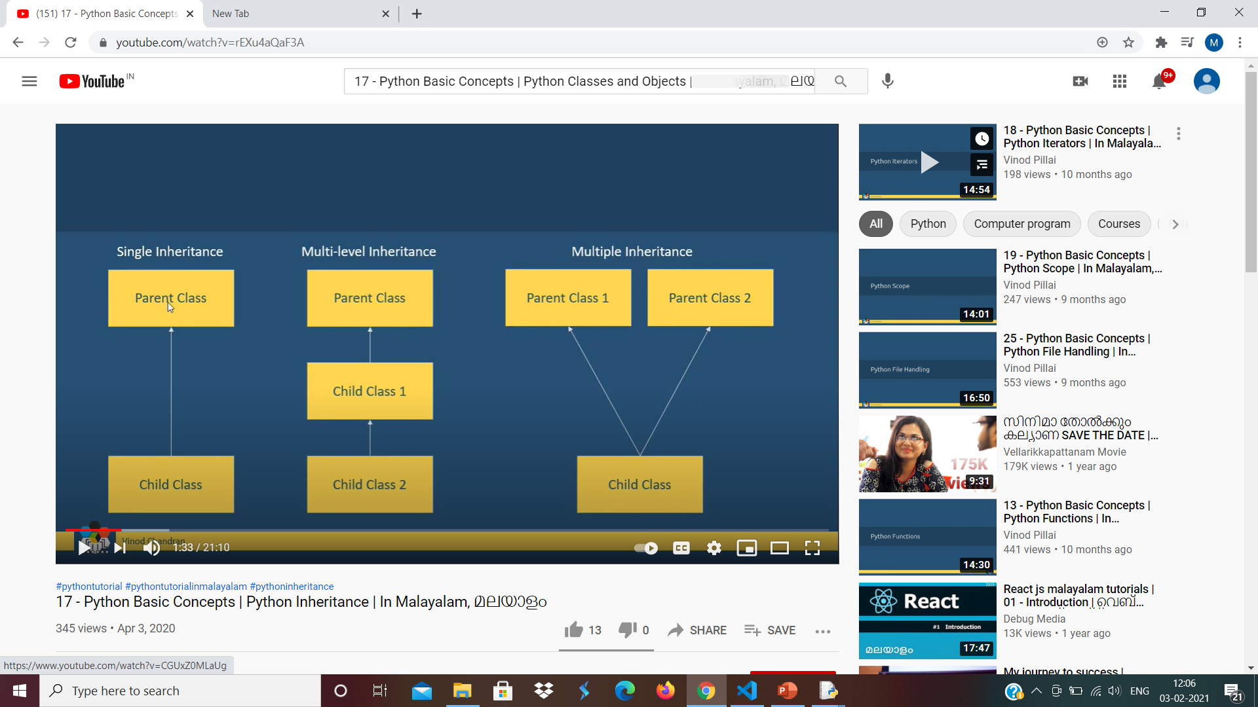
inheritance
Derived class inherits the properties & base class
Derived – child class
Base –parent class

Slide 84
Sample pgm
class Vehicle:
def __init__(self,brand,year):
self.year=year
self.brand=brand
def display(self):
print("Brand:",self.brand,"year:",self.year)
class Car:
def __init__(self,brand,year,name):
self.year=year
self.brand=brand
self.name=name
def display(self):
print("Brand:",self.brand,"year:",self.year,"Name:",self.name)
v=Vehicle("Maruti",2018)
v.display()
c=Car("Maruti",2018,"Alto")
c.display()

Slide 85
pgm
class Vehicle:
def __init__(self,brand,year):
self.year=year
self.brand=brand
def display(self):
print("Brand:",self.brand,"year:",self.year)
class Car(Vehicle):
def __init__(self,brand,year,name):
super().__init__(brand,year)
self.name=name
def display_name(self):
print("name:",self.name)
c=Car("Maruthi",2018,"Alto")
c.display()
c.display_name()

Slide 86
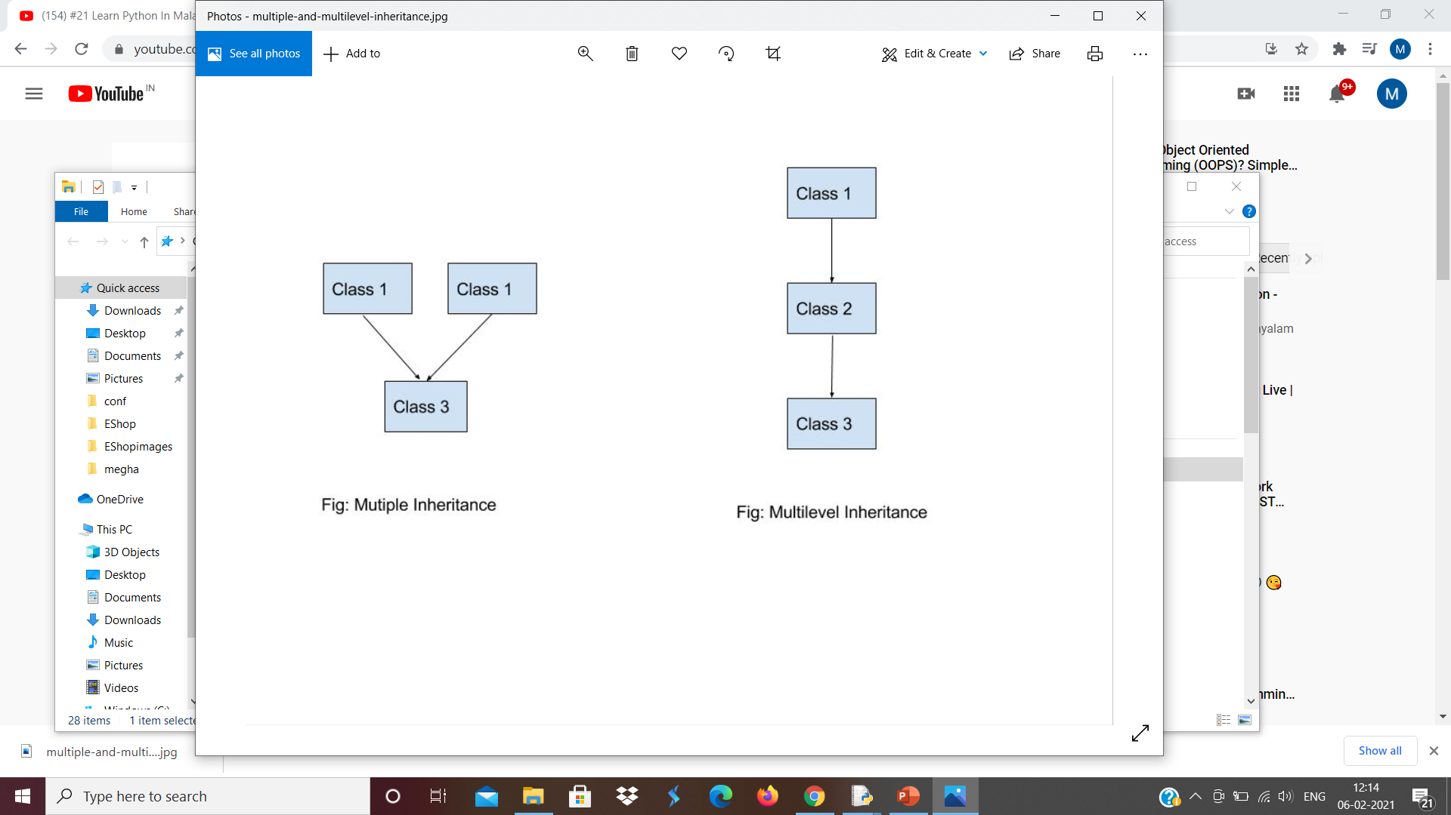
Multiple inheritance

Slide 87
pgm
class A:
def hi(self):
print("hi from class A")
class B:
def hello(self):
print("hello from class B")
class C(A,B):
pass
c_obj=C()
c_obj.hi()
c_obj.hello()

Slide 88
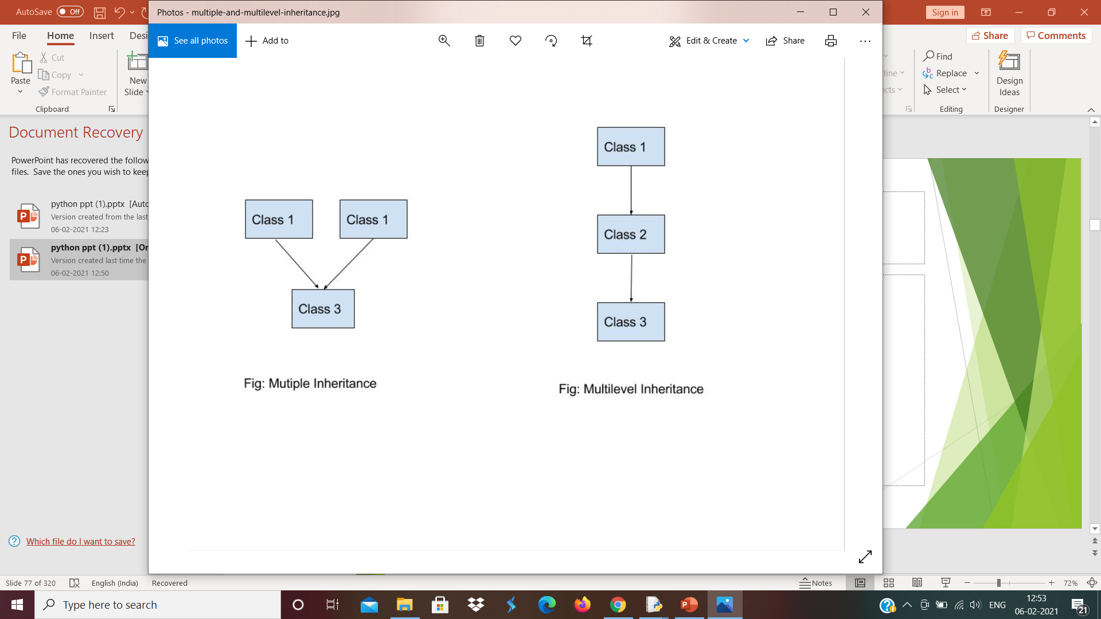
Multi-level inheritance

Slide 89
pgm
class A:
def hello(self):
print("hi from class A")
class B(A):
def hi(self):
print("hello from class B")
class C(B):
pass
c_obj=C()
c_obj.hi
c_obj.hello()

Slide 90
Files
Collection of data
Advantage of implement the files is in order to stored the output
2 types file
1.Text file
2.Binary file

Slide 91
Create a file object
Open()
Syntax
file_object=open(“filename.txt”,”Access Mode”)
File pointer- points to the content of file

Slide 92
Access modes
r – read mode
Only for reading the content
File pointer points at the beginning of the file
File should exist before opening in read mode
fp=open(“abc.txt”,”r”)

Slide 93
w-write mode
Only for writing the content
File pointer points at the beginning of the file
1. If the file exists the file is opened and pointer points at beginning and data will overwritten
Fp=(“abc.txt”,”w”)
2. If the file doesn’t exist then new file will be created with given file name

Slide 94
a - append mode
To append and write the data
File exist - file pointer points at the end of the content in file
File doesn’t exist – new file will be created and file pointer points at beginning
fp=(“abc.txt”,”a”)

Slide 95
Text files
r-reading
w-writing
a – appending/writing
r+ - reading and writing
w+ - reading and writing
a+ - reading and appending

Slide 96
Binary files
rb – reading
wb – writing
ab – appending
rb+ - reading and writing
wb+ -reading and writing
ab+ - appending and reading

Slide 97
read mode – file pointer at beginning
write mode – file pointer at beginning
Append – file pointer at the end of content

Slide 98
operations
Creating
Reading
Updating
Deletion
file.read()
file=open(“testfile.text”,”r”)
print(file.read())
or
print(file.read(5))

Slide 99
pgm1
import os
file=open(“…link..txt”,’r’) we love python
print(file.read()) or print(file.read(5))
file.close()

Slide 100
Ex-file=open(“testfile.text”,”r”)
print (file.readline()) --------→line by line
Ex-file=open(“testfile.text”,”r”)
print (file.readline(3)) --------→ Read 3rd line only
Ex-file=open(“testfile.text”,”r”)
Print (file.readlines()) --------→Readlines separately

Slide 101
demofile2.txt
Hello world
We love python
We love networkz
import os
file=open(“…..link……txt”,”r”)
print(file.readlines())
file.close() -----→[‘Hello world\n’we love python\n’,’we love networkz’]

Slide 102
program
f1=open(“abc.txt”,”w”)
f1.write(“welcome to python”)
F1.close()
f1=open(“abc.txt”,”r”)
Print(f1.read())

Slide 103
Exception
In any program language,
There are 2 types of possible errors
Syntax error
Runtime error

Slide 104
Syntax error
The errors which occur because of invalid syntax, such type of errors are considered as syntax errors
Programmer is responsible to correct these syntax errors. Once all syntax errors are corrected, then only program execution will be started.

Slide 105
ex –
x=10
if x==10
print(‘x value is 10’)
ex –
print “Hello Friends”

Slide 106
Runtime Error
Also known as exception
While executing the program, at runtime if something goes wrong because of end user input ,memory problems, programming logic etc. then we will get runtime errors.
Exception handling concept applicable for runtime errors but not for syntax errors

Slide 107
Get runtime while executing the program something goes run because of memory problem, invalid input, logic mistake problem
ex –
x = int(input(‘Enter the first number’))
y = int(input(‘Enter the second number’))
print(‘The result:’,x/y)
ZeroDivisionError
Value error

Slide 108
Error handling
import sys
try:
n=input(‘Enter your name’)
except EOFError:
print(‘EOF error has occurred’)
sys.exit(1)
except:
print(‘some error has occurred’)
print(‘The name entered is’,n)

Slide 109
import sys
try:
n=input(‘Enter your name’)
except EOFError:
print(‘EOF error has occurred’)
sys.exit(1)
except:
print(‘some error has occurred’)
else:
print(‘The name entered is’,n)

Slide 110
GUI DEVELOPMENT USING TKINTER
GUI – GUI is a desktop application which helps you to interact with computers.
GUI
Text editors
Games
Apps

Slide 111
Python libraries for graphical user interface(GUI)
Tkinter – Tkinter is the python interface to the TK GUI toolkit shipped with python
PyQt – This is also a python interface for a popular cross-platform Qt GUI library

Slide 112
What is Tkinter ?
Tkinter in python GUI programming is standard python GUI library, it gives us an object oriented interface to the TK GUI toolkit.

Slide 113
First window using TKinter
Import the tkinter module.
Create the GUI application main window
Add widgets
Enter the main event loop

Slide 114
Ex –
import tkinter
window=tkinter .Tk()
#to rename the title of the window
window.title(“GUI”)
#pack is used to show the object in the windows
label=tkinter.Label(window,text=“Hello World”).pack()
window.mainloop()
Syntax -
obj=widget(window,option1=val1,option2=val2)

Slide 115
Adding widget to our application
A widget is an element of a graphical user interface(GUI) that displays information or provides a specific way for a user to interact with the operating system or an application.
Label
Button
Entry
ComboBox
CheckButton
Radio
MenuBar

Slide 116
Label – used to provide a single-line caption for other widgets
Button – most commonly used widget to invoke action upon user interaction
Entry – Display a single –line text field for accepting values from a user
CheckButton – multi selectable button
Radio – display a number of options as radio buttons to select only one option at a time
MenuBar – provides various commands contained inside Menubutton

Slide 117
Canvas – used to draw shapes, such as lines,shapes,image
ListBox – used to provide a list of options to a user
Menubutton – used to display menus in your application
Message – Display multiline textfields for accepting values from a user
Text – display text in multiple lines

Slide 118
Standard attributes
background(bg) – specifies the normal background color
borderwidth(bd) – specifies a value of width of the 3-D border
cursor – mouse cursor to be used
font – specifies font to use when drawing text inside the widget
foreground(fg) – specifies the normal foreground color
width – specifies an integer value indicating the desired width of the widget
anchor – specifies how the information in a widget (eg-text or a bitmap) is to be displayed in the widget. values N,NE,E,SE,S,SW,W,NW or CENTER

Slide 119
command – specifies a python command to associate with the widget invoked when mouse button 1 is released over the widget
height – specifies the desired height for the window
image – specifies an image to display in the widget
justify – must be LEFT,CENTER or RIGHT
padx,pady – specifies extra space to request for the widget in the x and y direction
state - NORMAL and DISABLED or NORMAL
text – specifies a string to be displayed inside the widget

Slide 120
Label
You can set the label font, so you can make it bigger and may be hold
Ex –
l1=Label(window,text=“Networkz”,font=(“ArialBold”,50))
l1.grid(column=0,rows=0)
changing the fontstyle and size

Slide 121
We can set the default window size using geometry function
Ex –
l1=Label(window,text=“Networkz”,font=(“ArialBold”,50))
window.geometry(‘350*200’)
l1.grid(column=0,row=0)
the above line sets the window width to 350 pixels and the height to 200 pixels

Slide 122
Button
Let’s start by adding the button to the window, the button is created and added to the window the same as the label
Ex-
bt=Button(window,text=“Enter”)
bt.grid(column=1,row=0)
using grid function to set the button position

Slide 123
You can change foreground for a button or any other widget using fg property
Also, you can change the background color for any widget using by property
Ex-
bt=Button(window,text=“Enter”,bg=“orange”,fg=“red”)
bt.grid(column=1,row=0)
changing the background and foreground color

Slide 124
Let’s add button click event
First, we will write the function that we need to execute when the button is clicked
Ex-
def clicked():
l1.configure(text=“Button was clicked”)
bt=Button(window,text=“Enter”,command=clicked)
wiring the button with the function

Slide 125
Entry
In the previous python GUI examples,we saw how to add simple widgets.now let’s try getting the user input using Tkinter Entry class(Tkinter textbox)
Ex-
txt=Entry(window,width=10) creating a textbox using Tkinter Entry class
txt.grid(column=1,row=0)
def clicked():
res=“welcome to” +txt.get() once the button is clicked show “welcome to” concatenated with l1.configure(text=res) the entered text
bt=Button(window,text=“Enter”,command=clicked)

Slide 126
Combobox
Combobox widgets are very easy to use and are widely used as well
Ex –
from tkinter.ttk import * adding the combobox items combo=Combobox(window) using the tuple
combo[‘values’]=(1,2,3,4,5,”Text”)
combo.current(3) setting the selected item
combo.grid(column=0,row=0)

Slide 127
Checkbutton
To create a Checkbutton widget,you can use Checkbutton class
Ex –
chk_state=BooleanVar() creating a variable of type BooleanVar chk_state.set(True) which is not a standard python variable,
it’s a tkinter variable
chk=Checkbutton(window,text=‘select’,var=chk_state)
chk.grid(column=0,row=0)
passing the chk_state to the Checkbutton
class to set the check state

Slide 128
Radio Button
To add radio buttons, simply you can use RadioButton class
Ex –
rad1=Radiobutton(window,text=python’,value=1) you should set the value for every
rad2=Radiobutton(window,text=java’,value=2) radio button with a different rad3=Radiobutton(window,text=php’,value=3) value, otherwise, they won’t work rad1.grid(column=0,row=0)
rad2.grid(column=1,row=0)
rad3.grid(column=2,row=0)

Slide 129
Geometric Management
All tkinter widgets will have geometric measurements
Geometry Manager Classes
pack() grid() place()
It organizes the widget it organizes the widgets its used to place the
In the block, which in table like structure widgets at a specific
mean It occupies the position you want
enire available width

Slide 130
import tkinter
w=tkinter.Tk()
w.mainloop()
import tkinter
from tkinter import *
w=Tk()
w.mainloop()
import tkinter
from tkinter import *
w=Tk()
b=Button(w,text=“show”)
b.place(x=20,y=20) or pack
w.mainloop()

Slide 131
import tkinter
from tkinter import *
w=Tk()
def show():
print(“abc”)
b=Button(w,text=“show”,command=show)
b.place(x=20,y=20) or pack
w.mainloop()

Slide 132
calculator
from tkinter import * def total(): a =int(num1.get()) b = int(num2.get()) c=a+b tot.set(c) return def differ(): a = int(num1.get()) b = int(num2.get()) d=a-b diff.set(d) return

Slide 133
window=Tk() window.geometry('500x500') window.title('calculator') num1=StringVar() num2=StringVar() tot=StringVar() diff=StringVar() label1=Label(window,text="num1",fg='blue',bg='white').grid(row=1,column=1) label2=Label(window,text="num2",fg='blue',bg='white').grid(row=2,column=1) entry1=Entry(window,textvariable=num1).grid(row=1,column=2) entry2=Entry(window,textvariable=num2).grid(row=2,column=2) entry3=Entry(window,textvariable=tot).grid(row=3,column=2) entry4=Entry(window,textvariable=diff).grid(row=4,column=2) btn1=Button(window,text="Sum",fg='red',bg='white', command=total).grid(row=3,column=1) btn2=Button(window,text="Differnce",fg='red',bg='white', command=differ).grid(row=4,column=1) window.mainloop()

Slide 134
MySQL
What is a Database?
A database is stores a collection of data
A database is an organized collection of data It is a collection of schemas, tables, queries

Slide 135
Define RDBMS & its Terminology
A Relational DataBase Management System (RDBMS) is a software that
Enables you to implement a database with tables, columns
Guarantees the Referential Integrity between rows of various tables.
Updates the indexes automatically.
Interprets an SQL query and combines information from various tables.

Slide 136
RDBMS Terminology
Table − A table is a matrix with data. A table in a database looks like a simple spreadsheet.
Column − One column (data element) contains data of one and the same kind, for example the
column postcode.
Row − A row ( record) is a group of related data, for example the data of one subscription.
Primary Key − A primary key is unique. A key value can not occur twice in one table. With a key, you can only find one row.
Foreign Key − A foreign key is the linking pin between two table
Redundancy − Storing data twice, redundantly to make the system faster.

Slide 137
Important SQL Commands
SELECT - extracts data from a database
UPDATE - updates data in a database
DELETE - deletes data from a database
INSERT INTO - inserts new data into a database
CREATE DATABASE - creates a new database
ALTER DATABASE - modifies a database
CREATE TABLE - creates a new table
ALTER TABLE - modifies a table
DROP TABLE - deletes a table
CREATE INDEX - creates an index (search key)
DROP INDEX - deletes an index

Slide 138
CREATE DATABASE Statement
CREATE DATABASE databasename;
Ex-CREATE DATABASE testDB;

Slide 139
CREATE TABLE Statement
CREATE TABLE table_name ( column1 datatype, column2 datatype, column3 datatype, .... );
CREATE TABLE Persons ( PersonID int, LastName varchar(255), FirstName varchar(255), Address varchar(255), City varchar(255) );

Slide 140
DROP TABLE Statement
DROP TABLE table_name;
Ex-DROP TABLE Persons;
DROP Database Statement
DROP DATABASE database_name;
Ex-DROP DATABASE test;

Slide 141
ALTER Query :
ALTER command is very useful when you want to change a name of your table, any table field or if you
want to add or delete an existing column in a table.
To DROP a column with ALTER :
ALTER TABLE table_name DROP COLUMN column_name;
ALTER TABLE Customers DROP COLUMN Email;
ii) To ADD a column with ALTER :
ALTER TABLE table_name ADD column_name datatype;
ALTER TABLE Customers ADD Email varchar(255);

Slide 142
DML commands(Data Manipulation Language)
SELECT Statement
The SELECT statement is used to select data from a database.
SYNTAX
SELECT column1, column2, ... FROM table_name;
SELECT * FROM table_name;
SELECT CustomerName, City FROM Customers;

Slide 143
INSERT INTO Statement
The INSERT INTO statement is used to insert new records in a table.
INSERT INTO table_name (column1, column2, column3, ...) VALUES (value1, value2, value3, ...);
INSERT INTO table_name VALUES (value1, value2, value3, ...);
INSERT INTO Customers (CustomerName, Address, City, PinCode, Country) VALUES (‘Ramu', ‘Networkz systems', ‘Ernakulam', '4006', 'Norway');

Slide 144
DELETE Statement
The DELETE statement is used to delete existing records in a table.
SYNTAX
DELETE FROM table_name WHERE condition;
DELETE FROM table_name;
DELETE FROM Customers WHERE CustomerName=‘Ammu';

Slide 145
UPDATE Statement
The UPDATE statement is used to modify the existing records in a table.
SYNTAX
UPDATE table_name SET column1 = value1, column2 = value2, ... WHERE condition;
UPDATE Customers SET ContactName = 'Ammu', City= ‘Kottayam' WHERE CustomerID = 1

Slide 146
clause
WHERE Clause
SYNTAX
SELECT column1, column2, ... FROM table_name WHERE condition;
SELECT * FROM Customers WHERE Country='Mexico';
SELECT * FROM Customers WHERE CustomerID=1;

Slide 147
AND /OR Clause
The AND and OR operators are used to filter records based on more than one condition:
The AND operator displays a record if all the conditions separated by AND are TRUE.
The OR operator displays a record if any of the conditions separated by OR is TRUE.
SELECT column1, column2, ... FROM table_name WHERE condition1 AND condition2 AND condition3 ...;
SELECT column1, column2, ... FROM table_name WHERE condition1 OR condition2 OR condition3 ...;

Slide 148
SELECT * FROM Customers WHERE Country='Germany' AND City='Berlin';
SELECT * FROM Customers WHERE City='Berlin' OR City='München';
IN Clause
SELECT column_name(s) FROM table_name WHERE column_name IN (value1, value2, ...);
SELECT * FROM Customers WHERE Country IN ('Germany', 'France', 'UK');

Slide 149
BETWEEN Clause
The BETWEEN operator selects values within a given range. The values can be numbers, text, or dates.
syntax
SELECT column_name(s) FROM table_name WHERE column_name BETWEEN value1 AND value2;
SELECT * FROM Products WHERE Price BETWEEN 10 AND 20;

Slide 150
ORDER BY
The ORDER BY keyword is used to sort the result-set in ascending or descending order.
syntax
SELECT column1, column2, ... FROM table_name ORDER BY column1, column2, ... ASC|DESC;
SELECT * FROM Customers ORDER BY Country;

Slide 151
COUNT Clause
The COUNT() function returns the number of rows that matches a specified criteria.
SELECT COUNT(column_name)
FROM table_name
WHERE CONDITION;

Slide 152
PyQt

Slide 153
type the following command in the terminal or command prompt:
pip install pyqt5

Slide 154
import sys
from PyQt5.QtWidgets import QApplication, QWidget
app=Qapplication(sys.argv)
window=Qwidget()
window.resize(320,240)
window.setWindowTittle(‘Networkz Systems’)
window.resize(500,500)
window.show()
sys.exit(app.exec_())

Slide 155
Using function
import sys
from PyQt5.QtWidgets import QApplication,QWidget
class App(QWidget):
def __init__(self):
super().__init__()
self.title=‘Networkz Systems’
self.left=10
self.top=10
self.width=640
self.height=480
self.home()
def home(self):
self.setWindowTItle(self.title)
self.setGeometry(self.left, self.top, self.width, self.height)
self.show()

Slide 156
If__name__==‘__main__’:
app=QAPPlication(sys.argv)
ex=App()
sys.exit(app.exec_())

Slide 157
label
import Qlabel
#in home(),
label1=Qlabel(‘id’,self)
label.move(280,100)

Slide 158
How to create a button
from PyQt5.QtWidgets import Qapplication,Qwidget,QPushButton
from PyQt5.QtCore import pyqtSlot
#In the home() method
button=QPushButton(‘submit’,self)
button.move(100,70)
#Add connect the method to the click with:
button.clicked.connect(self.on_click)
#we need to create a method for a button click:
@pyqtslot()
def on_click(self):
print(‘Pyqt5 button click’)
#main method

Slide 159
Textbox
from PyQt5.QtWidgets import QMainWindow,Qapplication,Qwidget,QPushButton,Qaction,QLineEdit,QMessageBox
#in the home() method
#create textbox
self.textbox=QLineEdit(self)
self.textbox.move(20,20)
self.textbox.resize(280,40)
#create a button
#connect button to function on_click
@pyqtSlot
def on_click(self):
textboxvalue=self.textbox.text()
QMessageBox.question(self,’message’,”you typed:”+textboxValue,QMessageBox.ok,QMessageBox.ok)
Self.textbox.setText(“”)

Slide 160
MessageBox
from PyQt5.QtWidgets import QApplication,QWidget,QPushButton,QMessageBox
#in the home() method we add these lines
buttonReply=QMessageBox.question(self,’message’,”Do you like PyQt5?”,QMessageBox.yes|QMessageBox.No)
If buttonReply==QMessageBox.yes:
print(‘yes clicked’)
else:
print(‘No clicked’)
self.show()

Slide 161
More buttons for a messagebox
buttonReply=QMessageBox.question(self,’message’,”Do you want to save?”, QMessageBox.yes|QMessageBox.No|QMessageBox.Cancel)
If buttonReply==QMessageBox.yes:
print(‘yes clicked’)
If buttonReply==QMessageBox.No:
print(‘No clicked’)
If buttonReply==QMessageBox.Cancel:
print(‘Cancel’)
self.show()

Slide 162
Menu
To create a menu for a PyQt5 program we need to use a QMainWindow
The top menu can be created with the method menubar()
Submenus are added with addMenu(name)
From PyQt5.QtWidgets import QMainWindow,QApplication,Qwidget,QPushButton,QAction
#in the home() method
mainMenu=self.menuBar()
filemenu=mainMenu.addMenu(‘File’)
editMenu=mainMenu.addMenu(‘Edit’)
viewMenu=mainMenu.addMenu(‘View’)
searchMenu=mainMenu.addMenu(‘Search’)
toolsMenu=mainMenu.addMenu(‘Tools’)
helpMenu=mainMenu.addMenu(‘Help’)

Slide 163
Individual buttons can be added to the menus
exitButton=Qaction(‘Exit’,self)
exitButton.setShortcut(‘ctrl+Q’)
exitButton.setStatusTip(‘Exit application’)
exitButton.triggered.connect(self.close)
fileMenu.addAction(exitButton)

Slide 164

HTML

Slide 165
INTRODUCTION
HTML stands for Hypertext Markup Language.
html is used to create web pages and web applications.
html is widely used language on the web.
we can create a static website by html only.
technically, html is a markup language rather than a programming language.

Slide 166
TERMS
Hyper Text: Hypertext simply means "text within text." a text has a link within it, is a hypertext.
Markup language: A markup language is a computer language .used to apply layout and formatting conventions to a text document. it can turn text into images, tables, links, etc.
Web Page: A web page is a document which is commonly written in html and translated by a web browser.
With the help of html only, we can create static web pages.

Slide 167
Features of HTML
Easy and simple language
Effective presentation
Mark-up language
Can add a link on the web pages
Platform-independent

Slide 168
simple example of html
<html>
<head>
<title>web page title</title>
</head>
<body>
<h1>first heading</h1>
<p>first paragraph.</p>
</body>
</html>

Slide 169
Description of example
<!doctype>: It defines the document type
<html > :This tag informs the browser that it is an html document. text between html tag describes the web document. it is a container for all other elements of html except <!doctype>
<head>: It should be the first element inside the <html> element. it must be closed before the body tag opens
<title>: As its name suggested, it is used to add title of that html page which appears at the top of the browser window. it must be placed inside the head tag and should close immediately. (optional)
Text between body tag describes the body content of the page that is visible to the end user. this tag contains the main content of the html document.
<h1> : Text between <h1> tag describes the first level heading of the webpage.
<p> : Text between <p> tag describes the paragraph of the webpage.

Slide 170
HTML Tags
Html tags are like keywords which defines that how web browser will format and display the content.
Html tags contain three main parts: opening tag, content and closing tag. but some html tags are unclosed tags.
Every tag in html perform different tasks.
Syntax
<tag> content </tag>

Slide 171
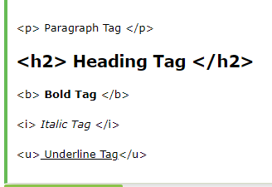
HTML Tag Examples

Slide 172
Unclosed HTML Tags
<br> Tag: break line, it breaks the line of the code.
<hr> Tag: Horizontal Rule. This tag is used to put a line across the webpage.

Slide 173
HTML FORMATTING
HTML Formatting is a process of formatting text for better look and feel.
These tags are used to make text bold, italicized, or underlined.

Slide 174
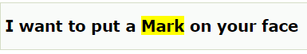
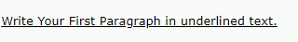
1) Bold Text: <p> <b>Write Your First Paragraph in bold text.</b></p> 2) Italic Text: <p> <i>Write Your First Paragraph in italic text.</i></p> 3) Marked formatting: <h2> I want to put a <mark> Mark</mark> on your face</h2> 4) Underlined Text: <p> <u>Write Your First Paragraph in underlined text.</u></p> 5) <em> : Defines emphasized text 6)<small>: Define small text. 7) <strong> :Define strong text 8)<sub> : Define subscripted text 9)<sup> : Define superscripted text 10)<code>: define computer code

Slide 175
HTML Anchor
The HTML anchor tag defines a hyperlink that links one page to another page.
It can create hyperlink to other web page as well as files, location, or any URL.
The “href ” attribute is used to define the address of the file to be linked.
Eg:
<a href="second.html">Click for Second Page</a>

Slide 176
HTML Image
HTML img tag is used to display image on the web page.
HTML img tag is an empty tag that contains attributes only.
Closing tags are not used in HTML image element.
Eg: <h2>HTML Image Example</h2>
<img src="good_morning.jpg" alt="Good Morning Friends"/>
src : Describes the source or path of the image. The location of image may be on the same directory or another server.
alt : Defines an alternate text for the image, if it can't be displayed. The value of the alt attribute describe the image in words.
width : It is an optional attribute which is used to specify the width to display the image.
height: It h3 the height of the image.

Slide 177
How to get image from another directory/folder? <img src="E:/images/animal.png" height="180" width="300" alt="animal image">

Slide 178
HTML Table
HTML table tag is used to display data in tabular form (row * column). There can be many columns in a row.
We can create a table to display data in tabular form, using <table> element, with the help of <tr> , <td>, and <th> elements.
Table row is defined by <tr> tag, table header is defined by <th>, and table data is defined by <td> tags.

Slide 179
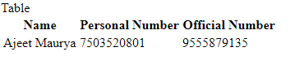
Table- Example
<html>
<head>Table<head>
<body>
<table>
<tr>
<th>Name</th>
<th>Personal Number</th>
<th>Official Number</th>
</tr>
<tr>
<td>Ajeet Maurya</td>
<td>7503520801</td>
<td>9555879135</td>
</tr>
</table>
</body>
</html>

Slide 180
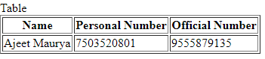
HTML Table with Border
<html>
<head>Table<head>
<body>
<table border=“1” >
<tr>
<th>Name</th>
<th>Personal Number</th>
<th>Official Number</th>
</tr>
<tr>
<td>Ajeet Maurya</td>
<td>7503520801</td>
<td>9555879135</td>
</tr>
</table>
</body>
</html>

Slide 181
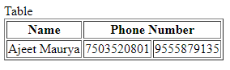
HTML Table with colspan
It will divide one cell/row into multiple columns, and the number of columns depend on the value of colspan attribute.
<table border="1">
<tr>
<th>Name</th>
<th colspan="2">Phone Number</th>
</tr>
<tr>
<td>Ajeet Maurya</td>
<td>7503520801</td>
<td>9555879135</td>
</tr>
</table>

Slide 182
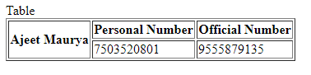
HTML Table with rowspan
It will divide a cell into multiple rows. The number of divided rows will depend on rowspan values
<table border="1">
<tr>
<th rowspan="2">Ajeet Maurya</th>
<th>Personal Number</th>
<th>Official Number</th>
</tr>
<tr>
<td>7503520801</td>
<td>9555879135</td>
</tr>
</table>

Slide 183
HTML Lists
HTML Lists are used to specify lists of information. All lists may contain one or more list elements. There are three different types of HTML lists:
1) Ordered List or Numbered List (ol) : all the list items are marked with numbers by default. It is known as numbered list also
2) Unordered List or Bulleted List (ul) : all the list items are marked with bullets. It is also known as bulleted list also
3) Description List or Definition List (dl) : It is also known as definition list where entries are listed like a dictionary or encyclopedia.

Slide 184
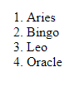
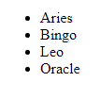
1) Ordered List(ol) & Unordered list(ul):
<ol >
<li>Aries</li>
<li>Bingo</li>
<li>Leo</li>
<li>Oracle</li>
</ol>
<ul>
<li>Aries</li>
<li>Bingo</li>
<li>Leo</li>
<li>Oracle</li> </ul>

Slide 185
3) Description List or Definition List (dl)
The HTML definition list contains following three tags:
1 <dl> tag defines the start of the list.
2 <dt> tag defines a term.
3 <dd> tag defines the term definition (description).

Slide 186
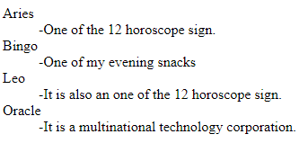
Example:
<dl>
<dt>Aries</dt>
<dd>-One of the 12 horoscope sign.</dd>
<dt>Bingo</dt>
<dd>-One of my evening snacks</dd>
<dt>Leo</dt>
<dd>-It is also an one of the 12 horoscope sign.</dd>
<dt>Oracle</dt>
<dd>-It is a multinational technology corporation.</dd>
</dl>

Slide 187
HTML FORMS
An HTML form is a section of a document which contains controls such as text fields, password fields, checkboxes, radio buttons, submit button, menus etc.
An HTML form facilitates the user to enter data that is to be sent to the server for processing such as name, email address, password, phone number, etc. .
The <form> tag is used to create an HTML form:
<form>
.
input elements
.
</form>

Slide 188
Text Fields
<input type="text" /> defines a one-line input field that a user can enter text into:
<form>
First name: <input type="text" name="firstname" /><br />
Last name: <input type="text" name="lastname" />
</form>

Slide 189
Password field
It defines defines a password field:
<form>
Password: <input type="password" name="pwd" />
</form>
Note: The characters in a password field are masked (shown as asterisks or circles).

Slide 190
Radio Button
It defines a radio button. Radio buttons let a user select ONLY ONE of a limited number of choices:
<form>
Gender:<input type="radio" value="ghr" name="gender">MALE
<input type="radio" value="opk" name="gender">FEMALE<br></form>

Slide 191
Check Boxes
<input type="checkbox" /> defines a checkbox. Checkboxes let a user select ONE or MORE options of a limited number of choices.
<form>
Languages known:<input type="checkbox" name="language" value="Bike" /> Hindi
<input type="checkbox" name="language" value="fsf" /> English
<input type="checkbox" name="language" value="fshs" /> Malayalam
<input type="checkbox" name="language" value="sfhgs" /> Tamil<br></form>

Slide 192
Submit Button
<input type="submit" /> defines a submit button.
A submit button is used to send form data to a server.The data is sent to the page specified in the form's action attribute.The file defined in the action attribute usually does something
with the received input:
<form name="input" action="html_form_action.asp" method="get">
Username: <input type="text" name="user" />
<input type="submit" value="Submit" />
</form>

Slide 193
Dropdown List
<html>
<body>
<form action="">
State:<select>
<option value="saab">select</option>
<option value="volvo">Kerala</option>
<option value="fiat">Tamil Nadu</option>
<option value="audi">Kashmir</option>
</select></form>
</body>
</html>

Slide 194
Text Area
<html> <body> <p> This example cannot be edited because our editor uses a textarea for input, and your browser does not allow a textarea inside a textarea.
Eg:
<html>
<body>
< textarea rows="10" cols="30"> </textarea>
</body>
</html>

Slide 195
Button
<html>
<body>
<form action="">
<input type="button" value="Hello world!">
</form>
</body>
</html>

Slide 196
HTML Form Example
<!DOCTYPE html>
<html>
<head>
<title>Form in HTML</title>
</head>
<body>
<h2>Registration form</h2>
<form>
<fieldset>
<legend>User personal information</legend>
<label>Enter your full name</label><br>
<input type="text" name="name"><br>
<label>Enter your email</label><br>
<input type="email" name="email"><br>
<label>Enter your password</label><br>

Slide 197
<input type="password" name="pass"><br> <label>confirm your password</label><br> <input type="password" name="pass"><br> <br><label>Enter your gender</label><br> <input type="radio" id="gender" name="gender" value="male"/>Male <br> <input type="radio" id="gender" name="gender" value="female"/>Female <br/> <input type="radio" id="gender" name="gender" value="others"/>others <br/> <br>Enter your Address:<br> <textarea></textarea><br> <input type="submit" value="sign-up"> </fieldset> </form> </body> </html>

Slide 198
Cascading Style Sheet (CSS )

Slide 199
INTRODUCTION
CSS is used to design HTML tags.
CSS is a widely used language on the web.
HTML, CSS and JavaScript are used for web designing. It helps the web designers to apply style on HTML tags.
CSS Example :
h1{
color:white;
background-color:red;
padding:5px;
}

Slide 200
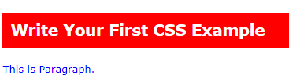
Example: <!DOCTYPE> <html> <head> <style> h1{ color:white; background-color:red; padding:5px; } p{ color:blue; } </style> </head> <body> <h1>Write Your First CSS Example</h1> <p>This is Paragraph.</p> </body> </html>

Slide 201
CSS Comments
Comments are used to explain your code
A CSS comment begins with
"/*", and ends with "*/", like this:
/*This is a comment*/
p
{
text-align:center;
/*This is another comment*/
color:black;
font-family:arial;
}

Slide 202
CSS Selector
CSS selectors are used to select the content you want to style.
Selectors are the part of CSS rule set.
CSS selectors select HTML elements according to its id, class, type, attribute etc.
The main selector types are;
1. CSS Element Selector
2. CSS Id Selector
3. CSS Class Selector
4. CSS Group Selector

Slide 203
1) CSS Element Selector
The element selector selects the HTML element by name.
<html>
<head>
</head>
<style>
p{
text-align:center;
color:blue;
}
</style>
<body>
<p> WELCOME<p>
</body>
</html>

Slide 204
2) CSS Id Selector
The id selector selects the id attribute of an HTML element to select a specific element.
It is written with the hash character (#), followed by the id of the element.
<html>
<head>
</head>
<style>
#happy{
text-align:center;
color:red;
}
</style>
<body>
<p id="happy"> WELCOME</p>
<p>HOW ARE YOU</p>
</body>
</html>

Slide 205
3) CSS Class Selector
The class selector is used to specify a style for a group of elements. Unlike the id selector, the class selector is most often used on several elements
This allows you to set a particular style for many HTML elements with the same class
The class selector uses the HTML class attribute, and is defined with a "."

Slide 206
<!DOCTYPE html> <html> <head> <style> .center { text-align: center; color: blue; } </style> </head> <body> <h1 class="center">This heading is blue and center-aligned.</h1> <p class="center">This paragraph is blue and center-aligned.</p> </body> </html>

Slide 207
4) CSS Group Selector
The grouping selector is used to select all the elements with the same style definitions.
Grouping selector is used to minimize the code.
<!DOCTYPE html>
<html>
<head>
<style>
h1, h2, p {
text-align: center;
color: blue;
}
</style>
</head>
<body>
<h1>Hello Javatpoint.com</h1>
<h2>Hello Javatpoint.com (In smaller font)</h2>
<p>This is a paragraph.</p>
</body>
</html>

Slide 208
Styles in CSS
There are 3 ways to insert an CSS
1) External style sheet
2) Internal style sheet
3) Inline style

Slide 209
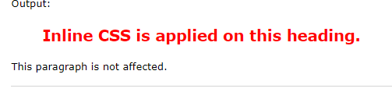
1) Inline CSS
Inline CSS is used to apply CSS on a single line or element.
<h2 style="color:red;margin-left:40px;">Inline CSS is applied on this heading.</h2>
<p>This paragraph is not affected.</p>

Slide 210
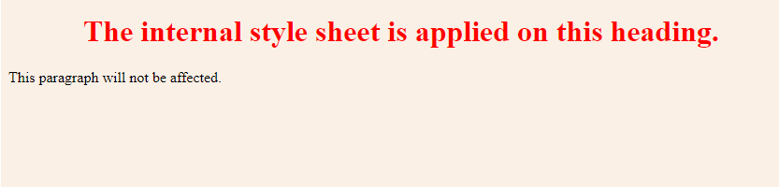
2) Internal CSS
The internal style sheet is used to add a unique style for a single document.
It is defined in <head> section of the HTML page inside the <style> tag.
<html>
<head>
<style>
body {
background-color: linen; }
h1 {
color: Red;
margin-left: 80px;}
</style>
</head>
<body>
<h1>The internal style sheet is applied on this heading.</h1>
<p>This paragraph will not be affected.</p>
</body>
</html>

Slide 211
3) External CSS
With an external style sheet, you can change the look of an entire Web site by changing one file.
Each page must link to the style sheet using the <link> tag.
An external style sheet can be written in any text editor.
The file should not contain any html tags. The REL attribute is used to define the relationship between the linked file and the HTML document.
Your style sheet should be saved with a .css extension.
page1.html
<html>
<head><link rel="stylesheet" type="text/css" href=“page2.css"> </head>
<body>
<h1>Good evening</h1>
<p>Have a nice day</p>
</body>
</html>

Slide 212
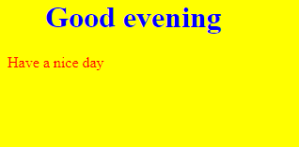
File : page2.css body { background-color: yellow; } h1 { color: blue; margin-left: 40px; } p{ color:red; }

Slide 213
JAVA SCRIPT

Slide 214
INTRODUCTION
JavaScript is an object-based scripting language which is lightweight and cross-platform.
JavaScript is not a compiled language, but it is a translated language.
The JavaScript Translator (embedded in the browser) is responsible for translating the JavaScript code for the web browser.

Slide 215
Application of JavaScript
Dynamic drop-down menus,
Displaying date and time,
Displaying pop-up windows and dialog boxes (like an alert dialog box, confirm dialog box and prompt dialog box),
Displaying clocks etc.

Slide 216
Description
To insert a JavaScript into an HTML page, use the <script> tag.
Inside the <script> tag use the type attribute to define the scripting language
The <script> and </script> tells where the JavaScript starts and ends.
The lines between the <script> and </script> contain the JavaScript and are execute by the browser.

Slide 217
Java script example
Javascript example is easy to code.
JavaScript provides 3 places to put the JavaScript code: within body tag, within head tag and external JavaScript file.
The script tag specifies that we are using JavaScript.
<script type="text/javascript">
document.write("JavaScript is a simple language");
</script>

Slide 218
1) JavaScript Example : code between the body tag
<body>
<script type="text/javascript">
alert("Hello Networkzsystems ");
</script>
</body>

Slide 219
2) JavaScript Example : code between the head tag
In this example, we are creating a function msg().
To create function in JavaScript, you need to write function with function_name as given below.
To call function, you need to work on event. Here we are using onclick event to call msg() function.
<html>
<head>
<script type="text/javascript">
function msg(){
alert("Hello Friend");
}
</script>
</head>
<body>
<p>Welcome to JavaScript</p>
<form>
<input type="button" value="click" onclick="msg()"/>
</form>
</body>
</html>

Slide 220
3) JavaScript Example : External JavaScript file
An external JavaScript file must be saved by .js extension. It is recommended to embed all JavaScript files into a single file. It increases the speed of the webpage.

Slide 221
Example
message.js
function msg(){
alert("Hello Networkzsystems");
}
Let’s include the JavaScript file into html page. It calls the JavaScript function on button click.

Slide 222
index.html
<html>
<head>
<script type="text/javascript" src="message.js"></script>
</head>
<body>
<p>Welcome to JavaScript</p>
<form>
<input type="button" value="click" onclick="msg()"/>
</form>
</body>
</html>

Slide 223
Manipulating HTML Elements
JavaScript is typically used to manipulate existing HTML elements.
The HTML "id" attribute is used to identify HTML elements.
To access an HTML element from a JavaScript, use the document.getElementById()method.
The document.getElementById() method will access the HTML element with the specified id.

Slide 224
Example
Access the HTML element with the specified id, and change its content:
<html>
<body>
<h1>My Web Page</h1>
<p id="demo">A Paragraph.</p>
<script type="text/javascript">
document.getElementById("demo").innerHTML="My First JavaScript";
</script>
</body>
</html>

Slide 225
Java script functions and events
Sometimes we want to execute a JavaScript when an event occurs, such as when a user clicks a button.
Then we put the script inside a function.
Functions are normally used in combination with events.

Slide 226
JavaScript Functions in <head>
<html><head>
<script type="text/javascript">
function myFunction()
{
document.getElementById("demo").innerHTML=“Happy New Year”;
}
</script>
</head>
<body>
<h1>My Web Page</h1>
<p id="demo">A Paragraph</p>
<input type="button" onclick="myFunction()“ value=“Try It”>
</body>
</html>

Slide 227
JavaScript Functions in <body>
<html>
<body> <h1>My Web Page</h1>
<p id="demo">A Paragraph</p>
<button type="button" onclick="myFunction()">Try it</button>
<script type="text/javascript">
function myFunction()
{
document.getElementById("demo").innerHTML="My First JavaScript Function";
}
</script>
</body>
</html>

Slide 228
JavaScript Popup Boxes
JavaScript has three kind of popup boxes:
Alert box,
Confirm box
Prompt box.

Slide 229
Alert Box
An alert box is often used if you want to make sure information comes through to the user.
When an alert box pops up, the user will have to click "OK" to proceed.
Syntax:
alert(“sometext”);

Slide 230
Example:
<html>
<head>
<script type="text/javascript">
function showalert()
{
alert("I am an alert box!");
}
</script>
</head>
<body>
<input type="button" onclick="showalert()" value="Show alert box" />
</body>
</html>

Slide 231
Confirm Box
A confirm box is often used if you want the user to verify or accept something.
When a confirm box pops up, the user will have to click either "OK" or "Cancel“ to proceed.
If the user clicks "OK", the box returns true. If the user clicks "Cancel", the box returns false.
Syntax:
confirm("sometext");

Slide 232
Example
<html>
<head>
<script type="text/javascript">
function showconfirm()
{
var r=confirm("Press a button");
if (r==true)
{
alert("You pressed OK!");
}
else
{
alert("You pressed Cancel!");
} }
</script>

Slide 233
</head> <body> <input type="button" onclick= "showconfirm()" value="Show confirm box" /> </body> </html>

Slide 234
Prompt Box
A prompt box is often used if you want the user to input a value before entering a page.
When a prompt box pops up, the user will have to click either "OK" or "Cancel“ to proceed after entering an input value.
If the user clicks "OK" the box returns the input value. If the user clicks "Cancel“ the box returns null.
Syntax:
prompt("sometext","defaultvalue");

Slide 235
Example
<html>
<head>
<script type="text/javascript">
function showprompt()
{
var name=prompt("Please enter your name","Harry Potter");
if (name!=null && name!="")
{
document.write("<p>Hello " + name + "! How are you today?</p>");
}
}
</script>
</head>

Slide 236
<body> <input type="button" onclick="showprompt()" value="Show prompt box" /> </body> </html>

Slide 237
jQuery

Slide 238
INTRODUCTION
The purpose of jQuery is to make it much easier to use JavaScript on your website.
jQuery is a lightweight, "write less, do more", JavaScript library.
jQuery takes a lot of common tasks that requires many lines of JavaScript code to accomplish, and wraps it into methods that you can call with a single line of code.

Slide 239
jQuery Syntax
The jQuery syntax is tailor made for selecting HTML elements and perform some action on the element(s).
Basic syntax is: $(selector).action()
I. A $ sign to define/access jQuery
II. A (selector) to "query (or find)" HTML elements
III. A jQuery action() to be performed on the element(s)
Examples:
▪ $(this).hide() - hides the current element.
▪ $("p").hide() - hides all <p> elements.
▪ $(".test").hide() - hides all elements with class="test".
▪ $("#test").hide() - hides the element with id="test".

Slide 240
The Document Ready Event
You might have noticed that all jQuery methods in our examples, are inside a
document
ready event:
$(document).ready(function(){
// jQuery methods go here...
});

Slide 241
jQuery Element Selector
The jQuery element selector selects elements based on their tag names.
You can select all <p> elements on a page like this:
$("p")
Example
When a user clicks on a button, all <p> elements will be hidden:
Example
$(document).ready(function(){
$("button").click(function(){
$("p").hide();
});
});

Slide 242
The #ID Selector
The jQuery #id selector uses the id attribute of an HTML tag to find the specific element.
An id should be unique within a page, so you should use the #id selector when you want to find a single, unique element.
To find an element with a specific id, write a hash character, followed by the id of the element:
$("#test")
Example
When a user clicks on a button, the element with id="test" will be hidden:
$(document).ready(function(){
$("button").click(function(){
$("#test").hide();
});
});

Slide 243
The .Class Selector
The jQuery class selector finds elements with a specific class.
To find elements with a specific class, write a period character, followed by the name of the class:
$(".test")
Example
When a user clicks on a button, the elements with class="test" will be hidden:
$(document).ready(function(){
$("button").click(function(){
$(".test").hide();
});
});

Slide 244
Example:
<html>
<head>
<script src="https://ajax.googleapis.com/ajax/libs/jquery/3.4.1/jquery.min.js"></script>
<script>
$(document).ready(function(){
$("#hide").click(function(){
$("p").hide();
});
$("#show").click(function(){
$("p").show(); }); });
</script>
</head>
<body>
<p>
<b>Good morning, Have a nice day</b>
</p>
<button id="hide">Hide</button>
<button id="show">Show</button>
</body>
</html>

Slide 245
jQuery Toggle()
The jQuery toggle() is a special type of method which is used to toggle between the hide() and show() method.
It shows the hidden elements and hides the shown element.
Syntax:
$(selector).toggle();
$(selector).toggle(speed, callback);
$(selector).toggle(speed, easing, callback);
$(selector).toggle(display);
display: If true, it displays element. If false, it hides the element.

Slide 246
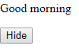
Example
<html>
<head>
<script src="https://ajax.googleapis.com/ajax/libs/jquery/3.4.1/jquery.min.js"></script>
<script>
$(document).ready(function(){
$("#hello").click(function(){
$("p").toggle();
});
});
</script>
</head>
<body>
<p> Good morning
</p>
<button id="hello">Hide</button>
</body>
</html>

Slide 247
jQuery- fadeIn() effect
<html>
<head>
<script src="https://ajax.googleapis.com/ajax/libs/jquery/3.4.1/jquery.min.js"></script>
<script>
$(document).ready(function(){
$("button").click(function(){
$("#div1").fadeIn(5000);
}); // color will fade slowly
});
</script>
</head>
<body>
<p> Good morning
</p>
<button>Click Here</button> <br><br>
<div id="div1" style="width:70px;height:40px;display:none;background-color:green;"> </div>
</body>
</html>

Slide 248
jQuery- fadeOut() effect
<html>
<head>
<script src="https://ajax.googleapis.com/ajax/libs/jquery/3.4.1/jquery.min.js"></script>
<script>
$(document).ready(function(){
$("button").click(function(){
$("#div1").fadeOut(2000);
});
});
</script>
</head>
<body>
<p> Good morning
</p>
<button>Click Here</button> <br><br>
<div id="div1" style="width:700px;height:400px;background-color:green;"> </div>
</body>
</html>

Slide 249
Database Connection
1Import sqlite3
2.con=sqlite3.connect(‘xyz.db’)
3.cur=con.cursor. ()
cur.execute()
cur.executemany()

Slide 250
Import sqlite3
from sqlite3 import Error
def conn():
try:
c=sqlite3.connect(‘test2.db’)
print(“connection established,DB is created”)
return c
except Error:
print(Error)
finally:
c.close()
def crt(c):
cur=c.cursor()
cur.execute(“CREATE TABLE table1(id integer PRIMARY KEY,name text,salary float)”)
c.commit()
c1=conn()
crt(c1)

Slide 251
insert
import sqlite3
c=sqlite3.connect(test2.db’)
def dti(c,data):
cur=c.cursor()
cur.execute(‘INSERT INTO table1(id,name,salary)VALUES(?,?,?)’,data)
c.commit()
data=(1,’xavier’,30000)
dti(c,data)

Slide 252
update
def dtu(c):
cur=c.cursor()
cur.execute(‘UPDATE table1 SET name=“Megha” where id=1’)
c.commit()
dtu(c)

Slide 253
Select from database
def dfa(c):
cur=c.cursor()
cur.execute(‘SELECT * FROM table1’)
r=cur.fetchall()
for i in r:
print(i)
dfa(c)

Slide 254
Insert many items to database
def dti(c,data):
cur=c.cursor()
cur.executemany(‘INSERT INTO table1(id,name,salary)VALUES(?,?,?)’,data)
c.commit()
data=[(3,’Annies’,50000),(4,’Mable’,40000),(5,’Mabin’,30000)]
dti(c,data)

Slide 255
delete
def dt(c):
cur=c.cursor()
cur.execute(‘DROP TABLE if exists table1’)
c.commit()
dt(c)

Slide 256
Database using tkinter
import tkinter
from tkinter import *
import sqlite3
t=tkinter.Tk()
t.geometry(“500x300”)
l=Label(t,text=“Registration Form”)
l.pack()
l1=Label(t,text=“ID”)
l1.place(x=100,y=50)
e1=Entry(t,bd=5)
e1.place(x=200,y=50)

Slide 257
l2=Label(t,text=“Name:”)
l2.place(x=100,y=50)
e2=Entry(t,bd=5)
e2.place(x=200,y=50)
l3=Label(t,text=“Name:”)
l3.place(x=100,y=50)
e3=Entry(t,bd=5)
e3.place(x=200,y=50)
def show():
a=int(e1.get())
b=int(e2.get())
c=int(e3.get())
print(a)
print(b)
print(c)

Slide 258
con=sqlite3.connect(‘test2.db’)
cur=con.cursor()
data=(a,b,c)
cur.execute(‘INSERT INTO table1(id,name,salary)VALUES(?,?,?)’,data)
con.commit()
e1.delete(0,END)
e2.delete(0,END)
e3.delete(0,END)
b=Button(t,text=“save”,command=show)
b.place(x=250,y=200)
t.main

Slide 259
Database using PyQt5
import sys
import sqlite3
from PyQt5.QtWidgets import QmainWindow,Qapplication,Qwidget,QPushButton,Qaction,QLineEdit,QM essageBox,Qlabel
from PyQt5.QtCore import pyqtSlot
class App(Qwidget):
def __init__(self):
super().__init__()
self.title=‘Networkz Systems’
self.left=10
self.top=10
self.width=640
self.height=480
self.home()

Slide 260
Def home(self):
super.setWindowTittle(self.title)
self.setGeometry(self.left,self.top,self.width,self.height)
label1=QLabel(‘Registration Form’,self)
label1.move(280,100)
label2=QLabel(‘Id’,self)
label2.move(100,150)
label3=QLabel(‘Name’,self)
label3.move(100,200)
label4=QL abel(‘Salary’,self)
label4.move(100,250)

Slide 261
self.textbox1=QLineEdit(self)
self.textbox1.move(300,200)
self.textbox1.resize(280,30)
self.textbox2=QLineEdit(self)
self.textbox2.move(300,250)
self.textbox2.resize(280,30)
self.textbox3=QLineEdit(self)
self.textbox3.move(150,350)
button.clicked.connect(self.on_click)
self.show()

Slide 262
@pyqtSlot()
Def on_click(self):
textboxValue1=int(self.textbox3.text())
print(textboxValue1)
textboxValue2=str(self.textbox3.text())
print(textboxValue2)
textboxValue3=float(self.textbox1.text())
print(textboxValue3)
c=sqlite3.connect(‘sample.db’)
cur=c.cursor()
data=(textboxValue1, textboxValue2, textboxValue3)
cur.execute(‘INSERT INTO employee(id,name,salary)VALUES(?,?,?)’,data)
c.commit()
self.textbox3.clear

Slide 263
If __name__==‘__main__’:
app=Qapplication(sys.argv)
ex=App()
sys.exit(app.exec_())

Slide 264
Django
High level python web framework
Allows rapid development and a clean design
Free and open source
Extremely fast
Excellent document

Slide 265
Django
What is Django?
Django is python based web framework which allow you to quickly create web application without all of the installation or dependency problems that you normally will find with other framework.
When you’re building a website, you always need a similar set of components: a way to handle user authentication (signing up, signing in, signing out), a management panel for your website, forms, a way to upload files, etc. Django give you ready-made components to use.

Slide 266
Why Django?
1.It’s very easy to switch database in Django framework.
2. It has built in admin interface which makes easy to work with it.
3. Django is fully functional framework that requires nothing else.
4. It has thousands of additional packages available.
5. It is very scalable.

Slide 267
Django – Design Philosophies
Django comes with the following design philosophies
Less Coding − Less code so in turn a quick development.
Fast Development − Django’s philosophy is to do all it can to facilitate hyper-fast development.
Clean Design − Django strictly maintains a clean design throughout its own code and makes it easy to follow best web-development practices.

Slide 268
Advantages of Django
Object-Relational Mapping (ORM) Support − Django provides a bridge between the
data model and the database engine, and supports a large set of database systems
including MySQL, Oracle, Postgres, etc. Django also supports NoSQL database through
Django-nonrel fork. For now, the only NoSQL databases supported are MongoDB and
google app engine.
Multilingual Support − Django supports multilingual websites through its built-in
internationalization system. So you can develop your website, which would support
multiple languages.
Framework Support − Django has built-in support for Ajax, Caching and various
other frameworks.
Administration GUI − Django provides a nice ready-to-use user interface for
administrative activities.
Development Environment − Django comes with a lightweight web server to facilitate
end-to-end application development and testing.

Slide 269
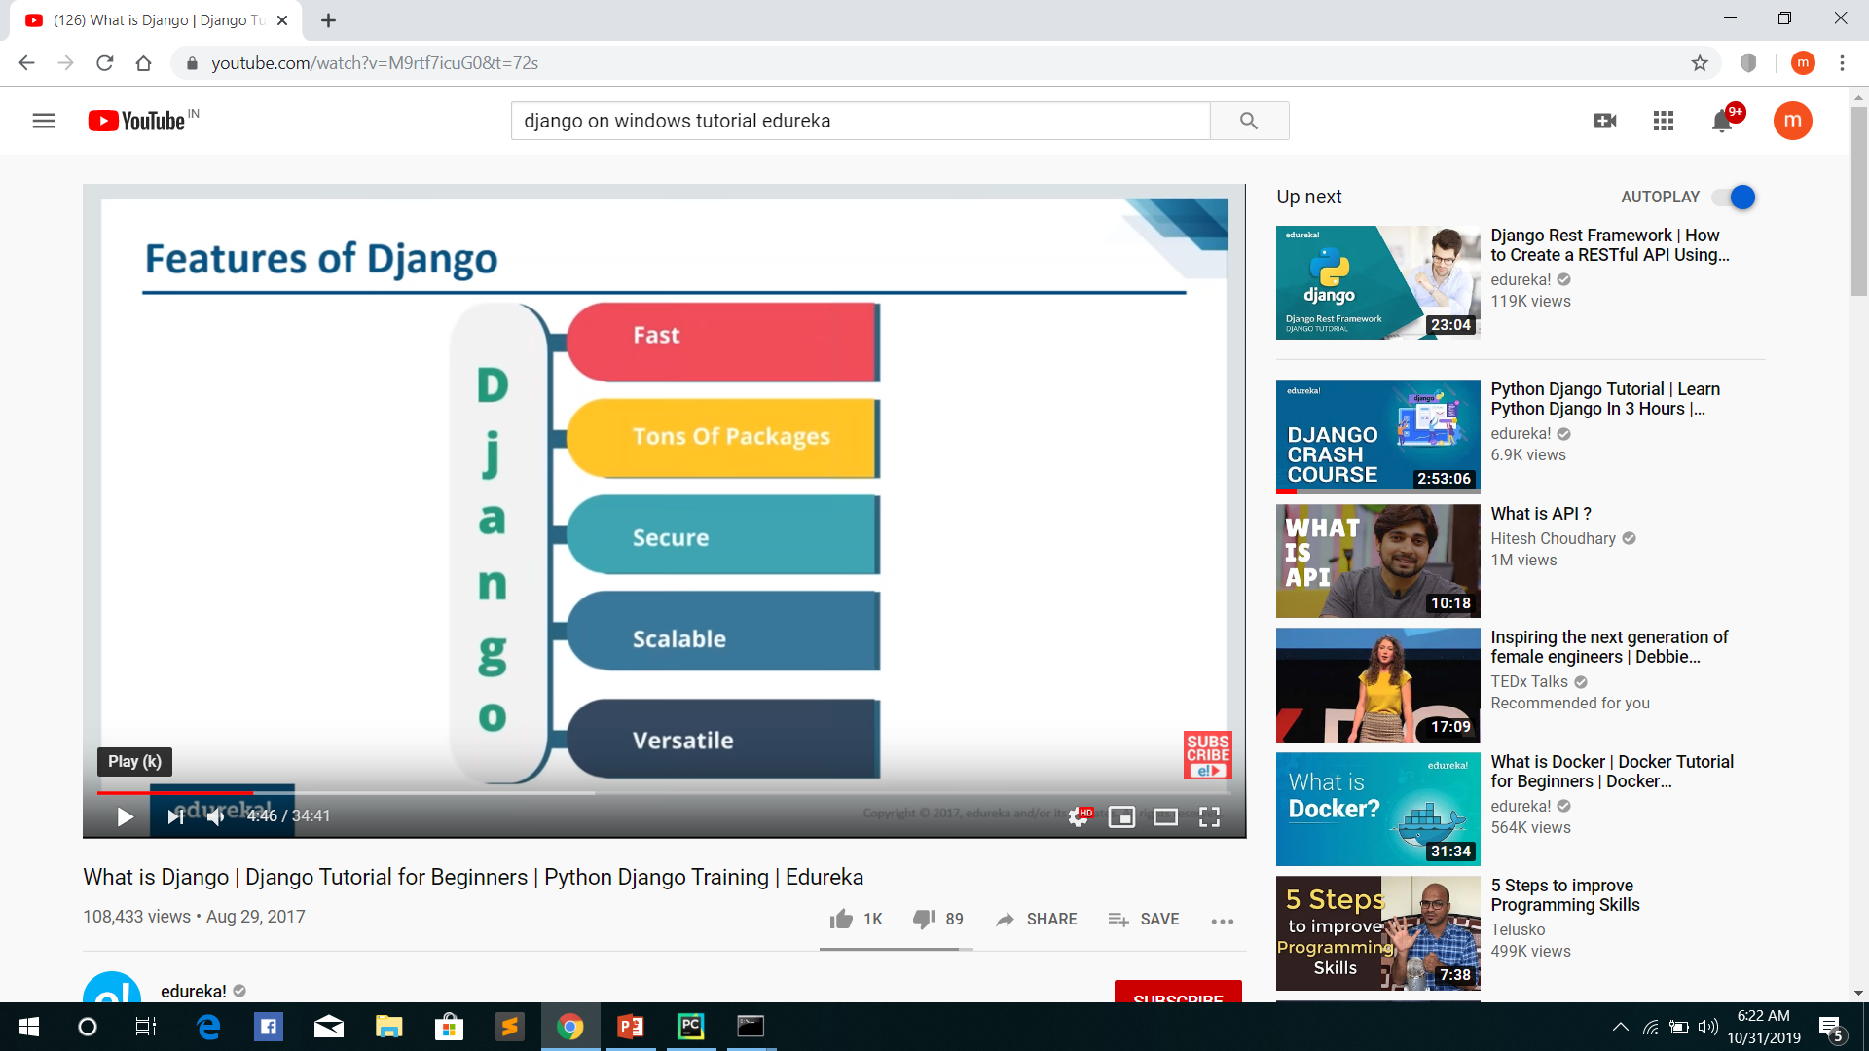

Slide 270
features of Django
Versatility of Django
Django can build almost any type of website. It can also work with any client side framework, and can deliver content in any format such as HTML, JSON, XML etc. Some sites which can be build using Django are wikis, social networks , new sites etc.
Security
Since Django framework is made for making web development easy, it has been engineered in such a way that it automatically do the right things to protect the website. For example, In Django framework instead of putting password in cookies the hashed password is stored in it so that it can’t be fetched easily by hackers.
Scalability
Django web nodes have no stored state, they scale horizontally – just fire up more of then when you need them. Being able to do this is the essence of good scalability. Instagram and Disqus are two Django based products that has millions of active users, this is taken as a example of scalability of Django
Portability
All the codes of Django framework is written in Python, which runs on many platforms. Which leads to run Django too in many platforms such as Linux, Windows and Mac OS.

Slide 271
HOW DOES DJANGO WORK?
Let’s understand MVC-MVT pattern

Slide 272
MVC Pattern
MVC pattern is based on three components: Model,
View, and Controller.

Slide 273
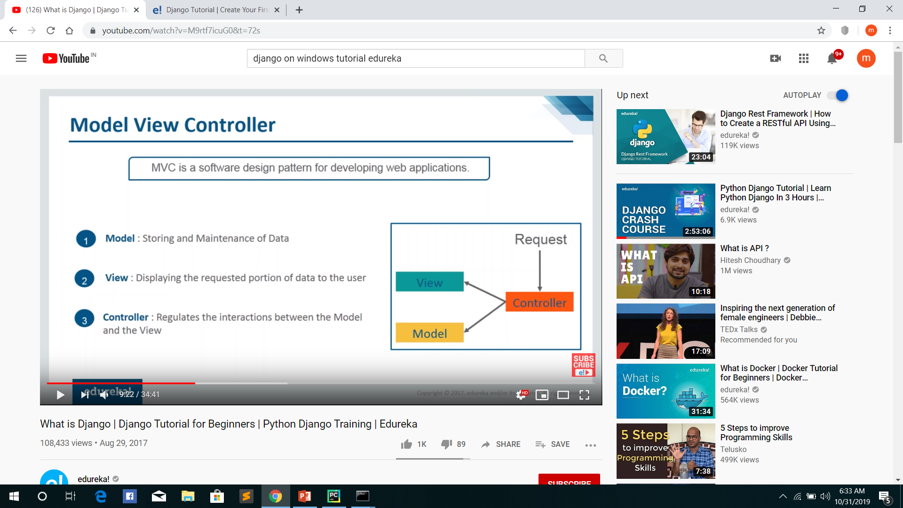

Slide 274
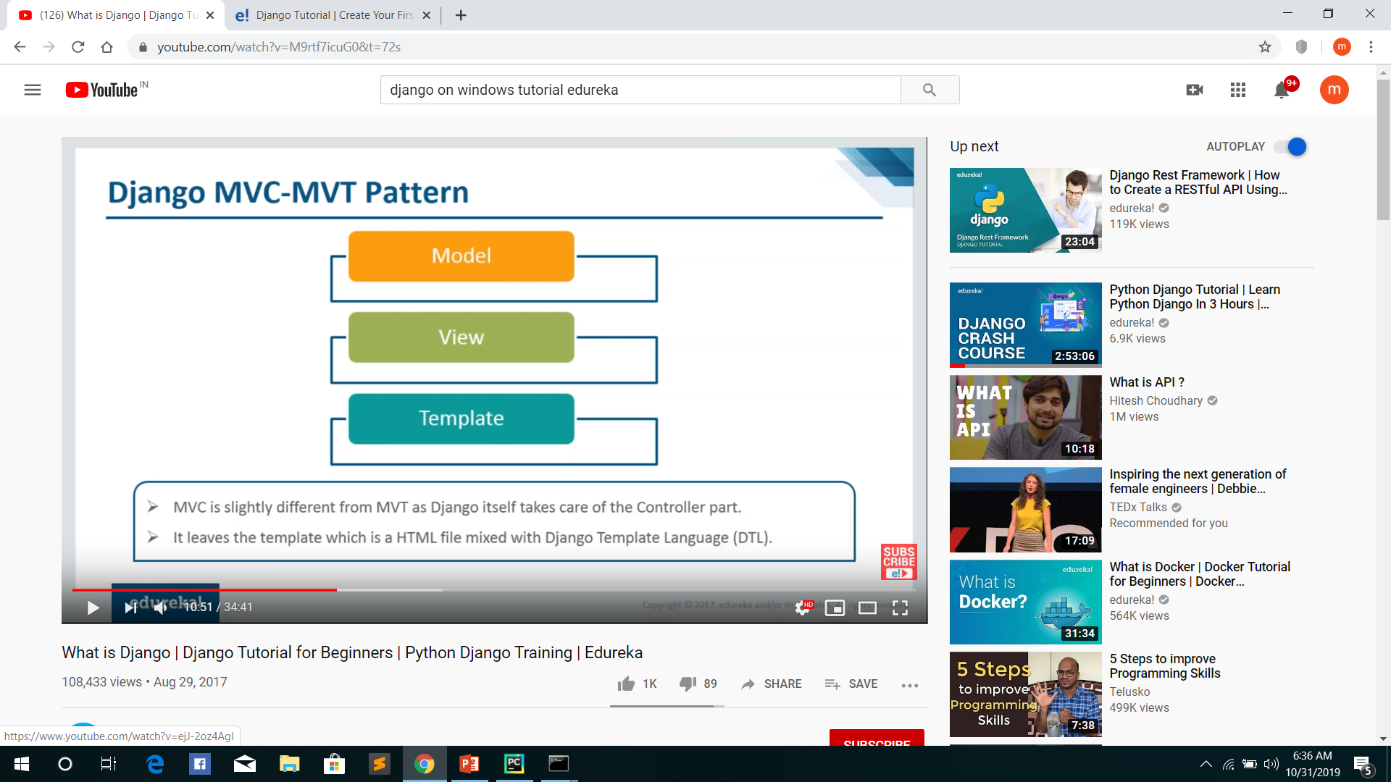

Slide 275
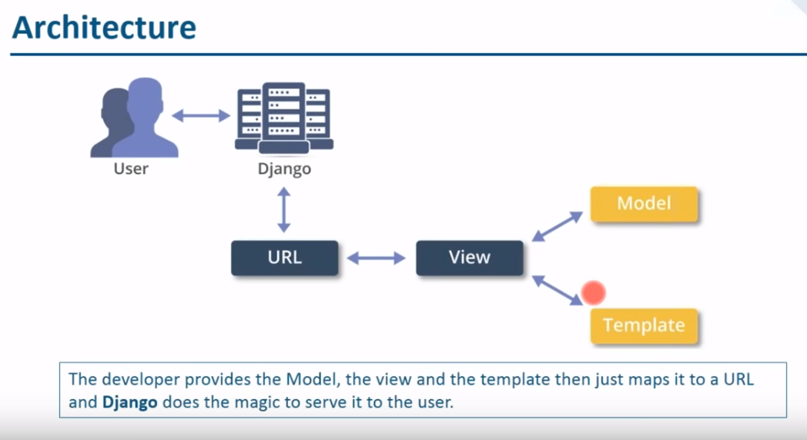

Slide 276
The Model-View-Template (MVT) is slightly different from MVC. In fact the
main difference between the two patterns is that Django itself takes care of
the Controller part (Software Code that controls the interactions between the
Model and View), leaving us with the template. The template is a HTML file
mixed with Django Template Language (DTL).

Slide 277
Installation of Django
Installation of Django in Linux and Mac is similar, here showing it in windows for
linux and mac just open terminal in place of command prompt and go through the
following commands.
• Install pip- Open command prompt and enter following command
o python -m pip install -U pip
• Install virtual environment- Enter following command in cmd-
o pip install virtualenv

Slide 278
Set Virtual environment- Setting up the virtual environment will allow you to edit the dependency which generally your system wouldn’t allow. Follow these steps to setup virtual environment-
Create a virtual environment by giving this command in cmd-
virtualenv my_site
2. Change directory to env_site by this command-
cd my_site
3. Go to Script directory inside my_site and activate virtual environment-
cd Scripts
activate

Slide 279
Install django by giving following command-
pip install django
Return to the my_site directory-
cd ..
Start a project by following command-
django-admin startproject networkz_site
Change directory to networkz_site
cd networkz_site

Slide 280
Django insatallation
Install django by giving following command-
pip install django
Return to the my_site directory-
cd ..
Start a project by following command-
django-admin startproject projectname
myproject/ manage.py myproject/ __init__.py settings.py urls.py wsgi.py

Slide 281
myproject/
manage.py
myproject/
__init__.py
settings.py
urls.py
wsgi.py
Change directory to networkz_site
cd networkz_site

Slide 282
Start a app by following command-
python manage.py startapp appname
Start the server- Start the server by typing following command in cmd-
python manage.py runserver
To check whether server is running or not go to web browser and enter
http://127.0.0.1:8000/ as url.
• manage.py-This file is used to interact with your project via command line(start the server, sync the database… etc).

Slide 283
folder ( networkz_site ) –This folder contains all the packages of your project. Initially it
contains four files –
_init_.py – It is python package.
settings.py – As the name indicates it contains all the website settings. In this file
we register any applications we create, the location of our static files, database configuration details, etc.
urls.py – In this file we store all links of the project and functions to call.
wsgi.py – This file is used in deploying the project in WSGI. It is used to help
your Django application communicate with the web server.

Slide 284
Create a project
Create a new file views.py inside the project folder where settings.py, urls.py and other files are stored and save the following code in it-
# HttpResponse is used to pass the information back to view
from django.http import HttpResponse
Defining a function which will receive request and perform task depending upon
function definition
def index(request) :
# This will return index string as HttpResponse
return HttpResponse(“<h1>Hello networkz systems</h1>)

Slide 285
app→urls
from django.urls import path
from.import views
Urlpatterns=[
path(‘’,views.index, name=‘index’),
]
Prj→urls
From django.contrib import admin
From django.urls import path,include
Urlpatterns=[
path(‘admin/’,admin.site.urls),
path(‘appname/’,include(‘appname.urls’)),
]

Slide 286
Start the server- Start the server by typing following command in cmd-
python manage.py runserver
Python manage.py migrate
python manage.py runserver
Checking – Open the browser and type this url-
http://127.0.0.1:8000/appname/

Slide 287
Django Views
A view is a place where we put our business logic of the application. The view is a python function which is used to perform some business logic and return a response to the user. This response can be the HTML contents of a Web page, or a redirect, or a 404 error.
All the view function are created inside the views.py file of the Django app.
Django View Simple Example
//views.py
import datetime
# Create your views here.
from django.http import HttpResponse
def index(request):
now = datetime.datetime.now()
html = ”<html><body><h3>Now time is %s.</h3></body></html>”% now
return HttpResponse(html) # rendering the template in HttpResponse

Slide 288
There are other output options though for the <label>/<input> pairs:
{{ form.as_table }} - will render them as table cells wrapped in <tr> tags
{{ form.as_p }} - will render them wrapped in <p> tags
{{ form.as_ul }} - will render them wrapped in <li> tags

Slide 289
Django Forms
Django provides a Form class which is used to create HTML forms. It describes a form and how it works and appears.
It is similar to the ModelForm class that creates a form by using the Model, but it does not require the Model.
Each field of the form class map to the HTML form <input> element and each one is a class itself, it manages form data and performs validation while submitting the form.

Slide 290
forms.py
from django import forms
class StudentForm(forms.Form):
firstname = forms.CharField(label="Enter first name",max_length=50)
lastname = forms.CharField(label="Enter last name", max_length = 100)
views.py
from django.shortcuts import render
from myapp.form import StudentForm
def index(request):
student = StudentForm()
return render(request,"index.html",{'form':student})

Slide 291
Index.html
<!DOCTYPE html>
<html lang="en">
<head>
<meta charset="UTF-8">
<title>Index</title>
</head>
<body>
<form method="POST" class="post-form">
{% csrf_token %}
{{ form.as_p }}
<button type="submit" class="save btn btn-default">Save</button>
</form>
</body>
</html>

Slide 292
Urls
from django.contrib import admin
from django.urls import path
from myapp import views
urlpatterns = [
path('admin/', admin.site.urls),
path('index/', views.index),
]

Slide 297
What is CRUD?
CRUD stands for Create, Read, Update & Delete. These are the four basic operations which are executed on Database Models. We are developing a web app which is capable of performing these operations.
Since we are developing a library app, let’s take an example of the same. In a library, books are objects. The books have attributes like name, author, etc. We need an application which can perform CRUD operations on book object. The CRUD operations are defined as follows

Slide 298
1. Read Operation
The ability of the application to read data from the database.
2. Create Operation
The ability of the application to store data in the database.
3. Update Operation
The ability of the application to edit the stored value in the database.
4. Delete Operation
The ability of the application to delete the value in the database.

Slide 299
Django CRUD (Create Read Update Delete) Example
Create a Project
django-admin startproject libraryapp
The project is made by Django. Now, the last command is to make a new application. Move to the directory of manage.py file and make a new app.
Create an App
python manage.py startapp book

Slide 300
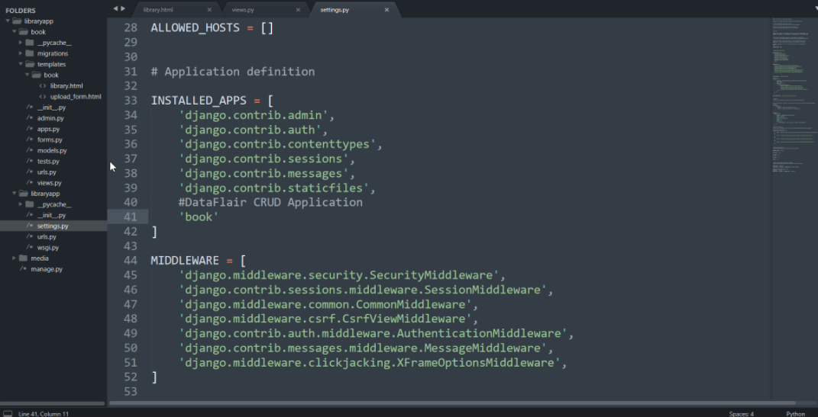
2. Installing Application and Other Important Settings
To install the app, just add the application’s name in the INSTALLED_APPS list. This is inside settings.py file.

Slide 301
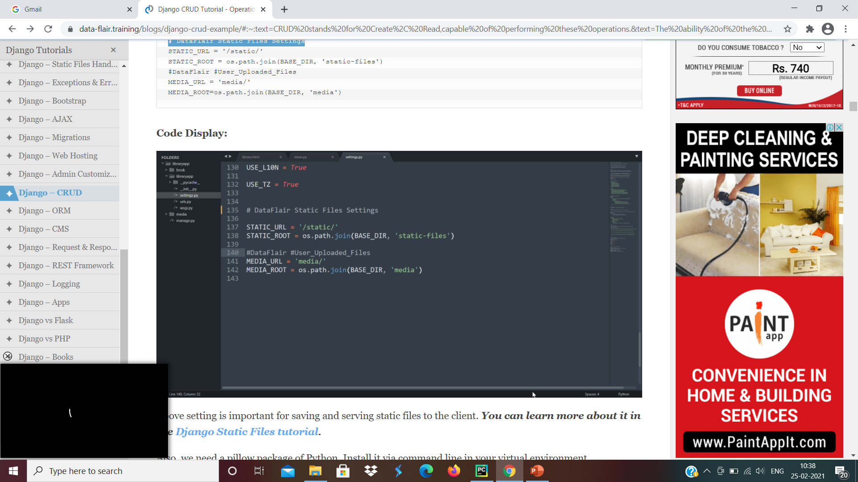
Once you complete this step, we also need to establish the Static Files Settings. Copy these settings as it is and replace it with the existing settings of your project.
# Static Files Settings STATIC_URL = '/static/' STATIC_ROOT = os.path.join(BASE_DIR, 'static-files') #User_Uploaded_Files MEDIA_URL = 'media/' MEDIA_ROOT=os.path.join(BASE_DIR, 'media')

Slide 302
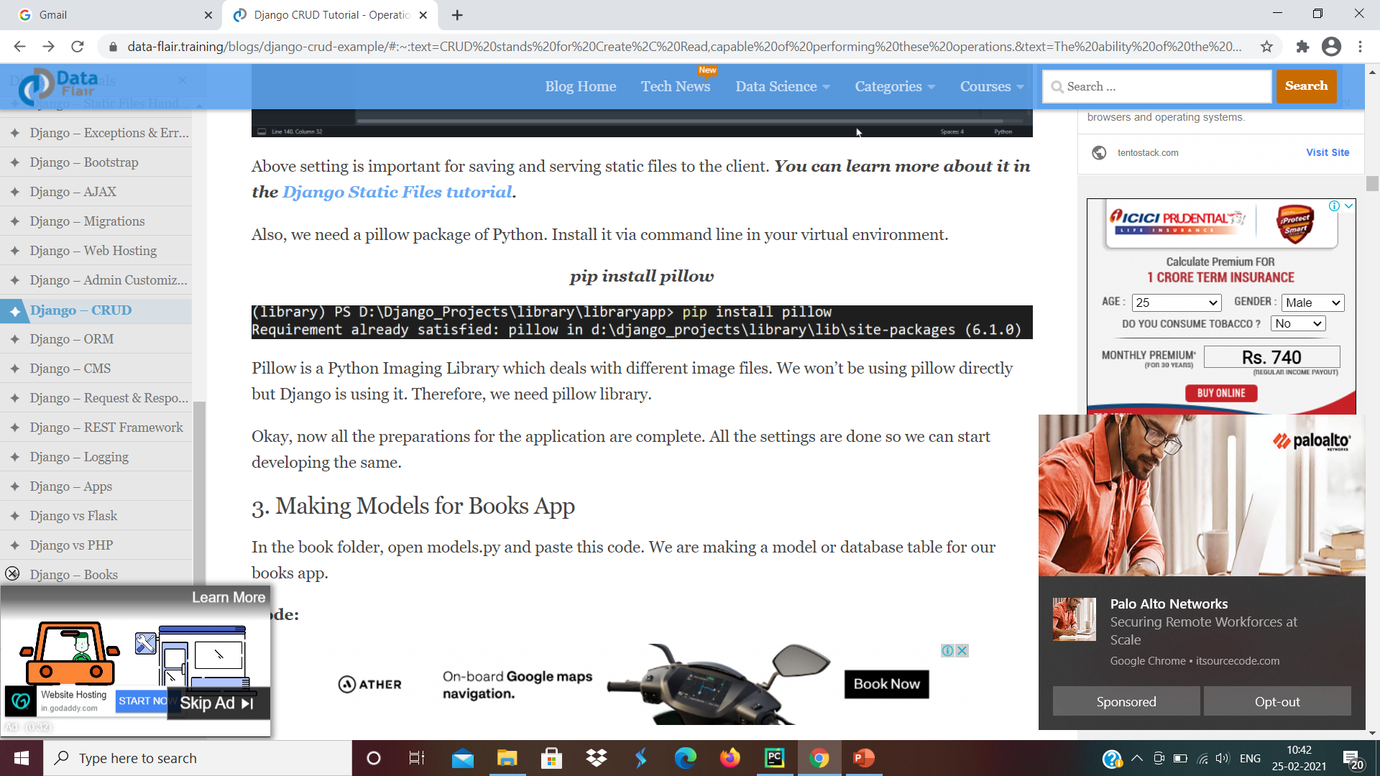
Also, we need a pillow package of Python. Install it via command line in your virtual environment
pip install pillow
Pillow is a Python Imaging Library which deals with different image files. We won’t be using pillow directly but Django is using it. Therefore, we need pillow library.
Okay, now all the preparations for the application are complete. All the settings are done so we can start developing the same.

Slide 303
3. Making Models for Books App
// models.py
from django.db import models class Book(models.Model): name = models.CharField(max_length = 50) picture = models.ImageField() author = models.CharField(max_length = 30, default='anonymous') email = models.EmailField(blank = True) describe = models.TextField(default = ‘Networkz Systems Django tutorials') def __str__(self): return self.name

Slide 304
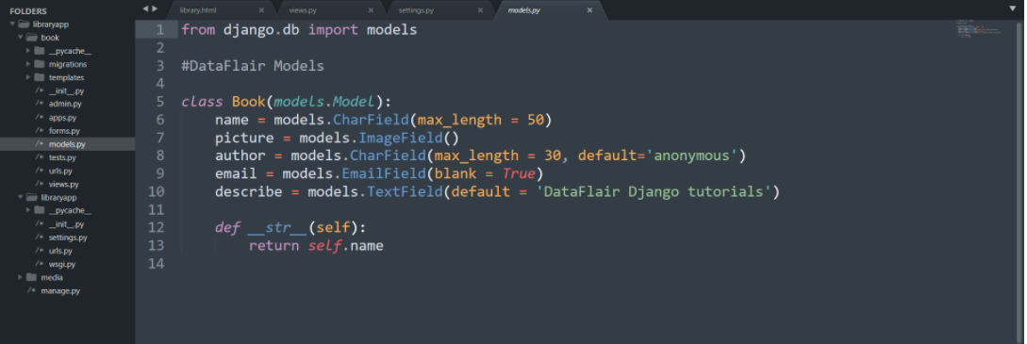
From the above code, Django will make a table in a database named book. That table will have these fields:
Name, picture, author, email, and description of the book object. From this class, we can easily manipulate the table. The important part here is the picture field. It is set as ImageField.
This ImageField is the reason why we installed pillow in this virtual environment. Django by default uses pillow to handle Images in ImageField. So, that was the models of our book app.

Slide 305
4. Making Model Forms in Book Directory
Django makes it so much easier to make forms for models. We just need to use our models and we can easily make forms.
Make a new file forms.py in book directory. Paste this code in this forms.py.
from django import forms from .models import Book class BookCreate(forms.ModelForm): class Meta: model = Book fields = '__all__'

Slide 306
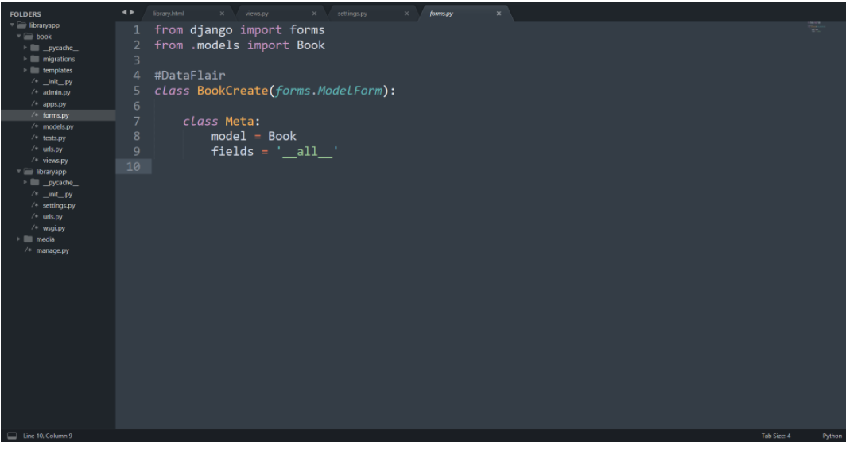

Slide 307
This is a simple model form we made for book model. Here we import two classes namely, forms and Book. The Book is the model we just made.
The BookCreate() class is the form class which represents the Model form. In the MetaClass, we define which model to be used to make the model form.
Fields denote the actual form fields where we want input from the user. This form is enough for our work
5. Registering Model in Django Admin
Here we are editing admin.py existing in book folder. Import the model you want to register in the admin. In this case, it is a Book.
from django.contrib import admin from .models import Book
admin.site.register(Book)

Slide 308
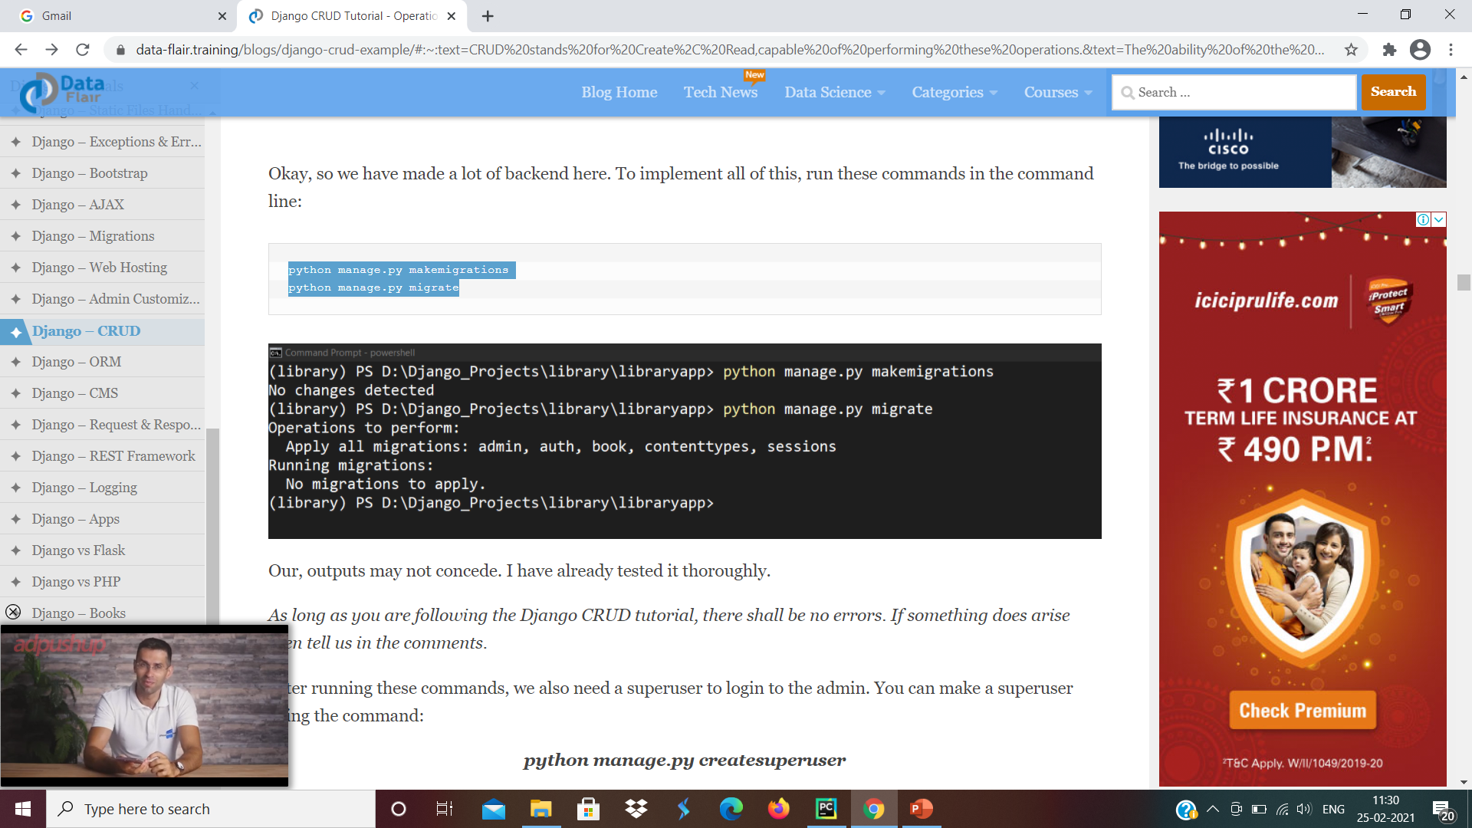
so we have made a lot of backend here. To implement all of this, run these commands in the command line:
python manage.py makemigrations
python manage.py migrate

Slide 309
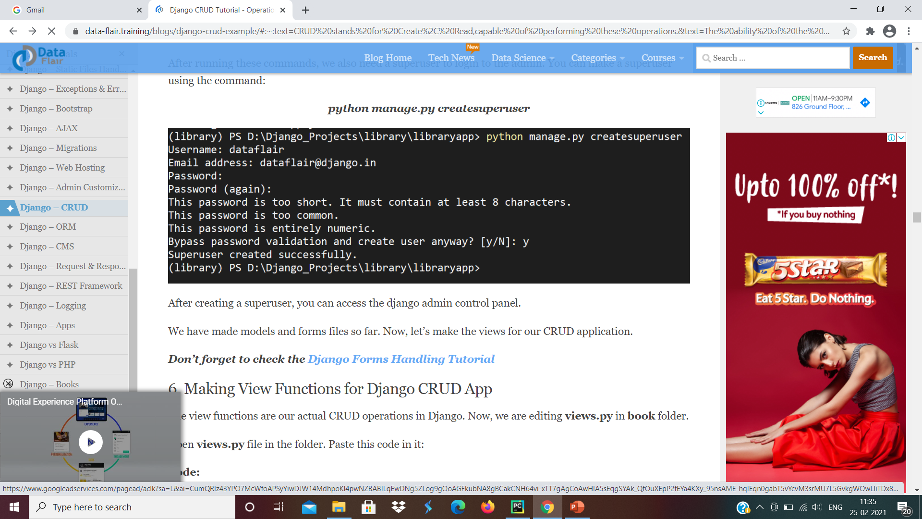
As long as you are following the Django CRUD tutorial, there shall be no errors. If something does arise then tell us in the comments.
After running these commands, we also need a superuser to login to the admin. You can make a superuser using the command:
python manage.py createsuperuser

Slide 310
After creating a superuser, you can access the django admin control panel.
We have made models and forms files so far. Now, let’s make the views for our CRUD application.
6. Making View Functions for Django CRUD App
The view functions are our actual CRUD operations in Django. Now, we are editing views.py in book folder.
from django.shortcuts import render, redirect from .models import Book from .forms import BookCreate from django.http import HttpResponse
def index(request): shelf = Book.objects.all() return render(request, 'book/library.html', {'shelf': shelf})

Slide 311
There is a lot of information in this file. views.py is one of the main backend components and is the business logic layer. So, let’s understand it step by step.
In this file, we have imported Book Model and BookCreate Form.
Index Function
This function is performing Read Operation. In this function, we simply retrieve all the objects in the book table. Those objects are then passed to the corresponding template.
We are using Querysets here for that purpose. Querysets is used to retrieve data from Tables. There are all kinds of filters and usage of Querysets and here we are using:
Book.objects.all()
It is clear from the query that it is passing a set of all objects in Book Table.

Slide 312
def upload(request): upload = BookCreate() if request.method == 'POST': upload = BookCreate(request.POST, request.FILES) if upload.is_valid(): upload.save() return redirect('index') else: return HttpResponse("""your form is wrong, reload on <a href = "{{ url : 'index'}}">reload</a>""") else: return render(request, 'book/upload_form.html', {'upload_form':upload})

Slide 313
2. Upload Function
This function is CREATE operation of CRUD. It is simply taking form data from the user and saving it in a database. Since we made a model form for that, we don’t need to validate data again. We can directly save the form info in the database.
We first create the form object. Then we check whether the form is submitting data or user is visiting for the first time.
If the form request method is POST, it means the form is being submitted. You can see, it is also checked whether the form also has an image file or not. The request.FILES is a dictionary-like object containing the FILES and other information.
Then we check whether the data entered by the user is correct or not. This is done by form_object.is_valid() method. This will return True or False whether the form_object holds valid data or not.
If the answer is True, we save the form data received in the database. form_object.save() accomplishes this and since it’s a model form, we can use it directly.
If we receive a GET request then we return an empty form. That’s how we can create an object in the database.

Slide 314
def update_book(request, book_id): book_id = int(book_id) try: book_sel = Book.objects.get(id = book_id) except Book.DoesNotExist: return redirect('index') book_form = BookCreate(request.POST or None, instance = book_sel) if book_form.is_valid(): book_form.save() return redirect('index') return render(request, 'book/upload_form.html', {'upload_form':book_form})

Slide 315
3. Update_book Function
The update_book Function is a bit similar to the Update Function. It does more than that though. The update_book function takes in two parameters from the request. The request itself and id number. The id number is used to identify the object which is to be edited.
You can pass it in as a URL or as a cookie. The session method is the most secure but we don’t need to use it here. So, the update_book function will check whether the book_id is valid or not.
If the object exists it will return the form filled with the object’s information in it. The user can change the form again. In this case, there will be no creation of new book but the editing of the existing book object.

Slide 316
def delete_book(request, book_id): book_id = int(book_id) try: book_sel = Book.objects.get(id = book_id) except Book.DoesNotExist: return redirect('index') book_sel.delete() return redirect('index')

Slide 317
4. Delete Function
Delete Function is the last function of the CRUD application. We are again using the same object method as with Update book function. We are passing the request and book_id to delete the book.
This is a simpler interpretation of update_book function.
The queryset book.objects.get(id = book_id) will check for the books having an id equal to book_id. Since book_id is a primary key, we will have only one object returned. We can delete that object easily by just executing:
Book.delete() method. This will delete the book from the database.
So, these were the view functions. Now, we are ready to make the templates and complete our app.

Slide 318
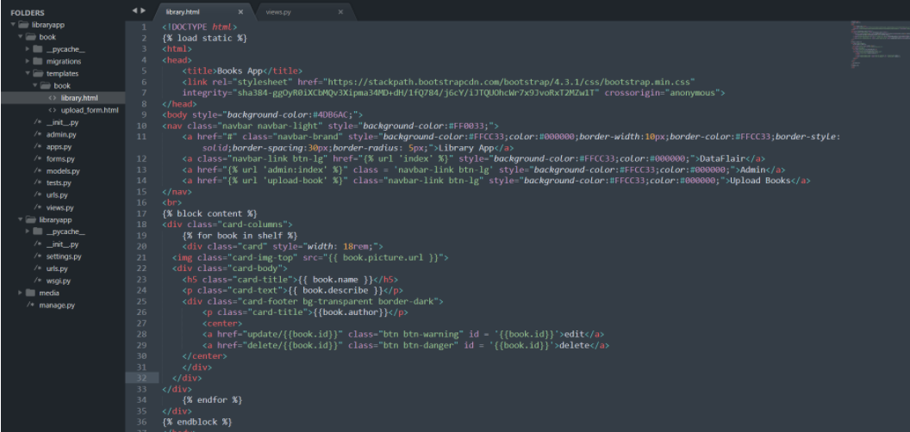
7. Making Templates
The first thing you need to do is to make the templates folder in the book folder. Inside book/templates, make another folder book. We are going to make all our templates in that folder.
Inside book/templates/book, make a new file:
library.html

Slide 319
<!DOCTYPE html> {% load static %} <html> <head> <title>Books App</title> <link rel="stylesheet" href="https://stackpath.bootstrapcdn.com/bootstrap/4.3.1/css/bootstrap.min.css" integrity="sha384-ggOyR0iXCbMQv3Xipma34MD+dH/1fQ784/j6cY/iJTQUOhcWr7x9JvoRxT2MZw1T" crossorigin="anonymous"> </head> <body style="background-color:#4DB6AC;"> <nav class="navbar navbar-light" style="background-color:#FF0033;"> <a href="#" class="navbar-brand" style="background-color:#FFCC33;color:#000000;border-width:10px;border-color:#FFCC33;border-style:solid;border-spacing:30px;border-radius: 5px;">Library App</a> <a class="navbar-link btn-lg" href="{% url 'index' %}" style="background-color:#FFCC33;color:#000000;">DataFlair</a> <a href="{% url 'admin:index' %}" class = 'navbar-link btn-lg' style="background-color:#FFCC33;color:#000000;">Admin</a> <a href="{% url 'upload-book' %}" class="navbar-link btn-lg" style="background-color:#FFCC33;color:#000000;">Upload Books</a> </nav>

Slide 320
{% block content %} <div class="card-columns"> {% for book in shelf %} <div class="card" style="width: 18rem;"> <img class="card-img-top" src="{{ book.picture.url }}"> <div class="card-body"> <h5 class="card-title">{{ book.name }}</h5> <p class="card-text">{{ book.describe }}</p> <div class="card-footer bg-transparent border-dark"> <p class="card-title">{{book.author}}</p> <center> <a href="update/{{book.id}}" class="btn btn-warning" id = '{{book.id}}'>edit</a> <a href="delete/{{book.id}}" class="btn btn-danger" id = '{{book.id}}'>delete</a> </center> </div> </div> </div> {% endfor %} </div> {% endblock %} </body> </html>

Slide 321
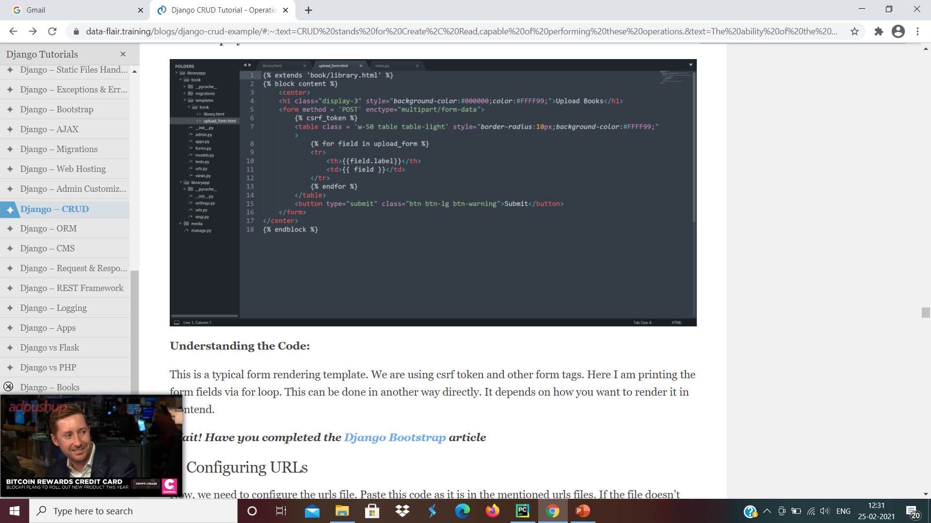
It’s a simple template file where we are displaying objects from a database. We are running a for loop to access the data in the dictionary we passed. All the other things are CSS and some Bootstrap Framework.
Upload_form.html

Slide 322
{% extends 'book/library.html' %} {% block content %} <center> <h1 class="display-3" style="background-color:#000000;color:#FFFF99;">Upload Books</h1> <form method = 'POST' enctype="multipart/form-data"> {% csrf_token %} <table class = 'w-50 table table-light' style="border-radius:10px;background-color:#FFFF99;"> {% for field in upload_form %} <tr> <th>{{field.label}}</th> <td>{{ field }}</td> </tr> {% endfor %} </table> <button type="submit" class="btn btn-lg btn-warning">Submit</button> </form> </center> {% endblock %}

Slide 323
This is a typical form rendering template. We are using csrf token and other form tags. Here I am printing the form fields via for loop. This can be done in another way directly. It depends on how you want to render it in frontend.
8. Configuring URLs
Urls.py
from django.contrib import admin from django.urls import path,include urlpatterns = [ path('admin/', admin.site.urls), path('', include('book.urls')) ]

Slide 324
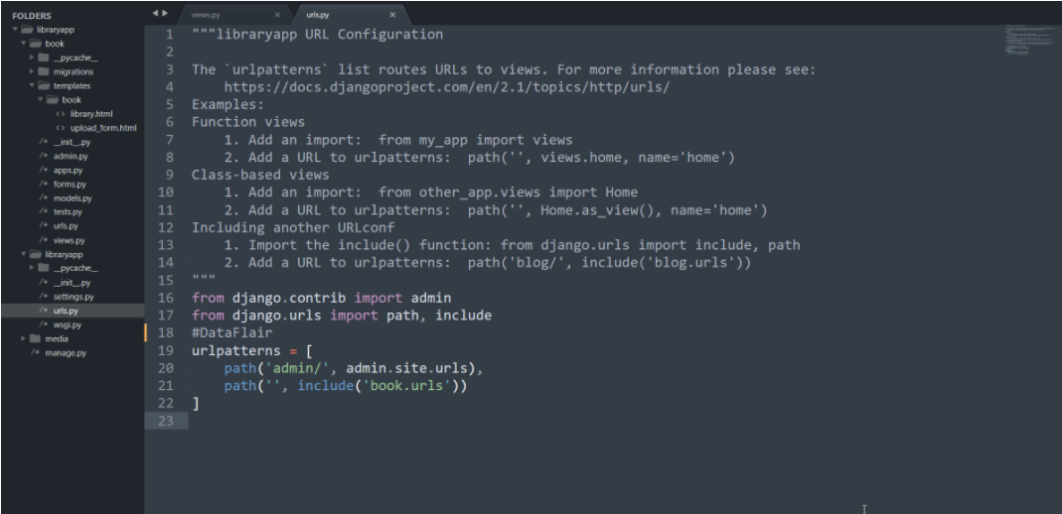

Slide 325
Book/urls.py
from django.urls import path from . import views from libraryapp.settings import DEBUG, STATIC_URL, STATIC_ROOT, MEDIA_URL, MEDIA_ROOT from django.conf.urls.static import static urlpatterns = [ path('', views.index, name = 'index'), path('upload/', views.upload, name = 'upload-book'), path('update/<int:book_id>', views.update_book), path('delete/<int:book_id>', views.delete_book) ] #DataFlair if DEBUG: urlpatterns += static(STATIC_URL, document_root = STATIC_ROOT) urlpatterns += static(MEDIA_URL, document_root = MEDIA_ROOT)

Slide 326
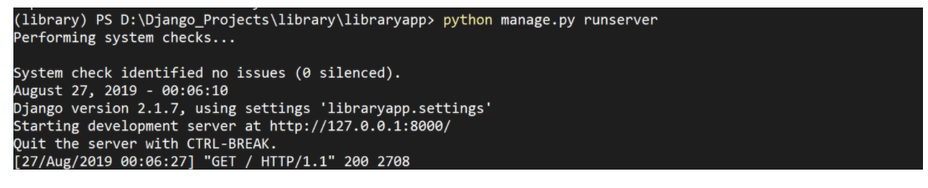
This file contains all the URL lookups for library app as well as settings for Django static files. These settings are used by Django to render the images with the book object.
9. Running Server and Testing
python manage.py runserver

Slide 327
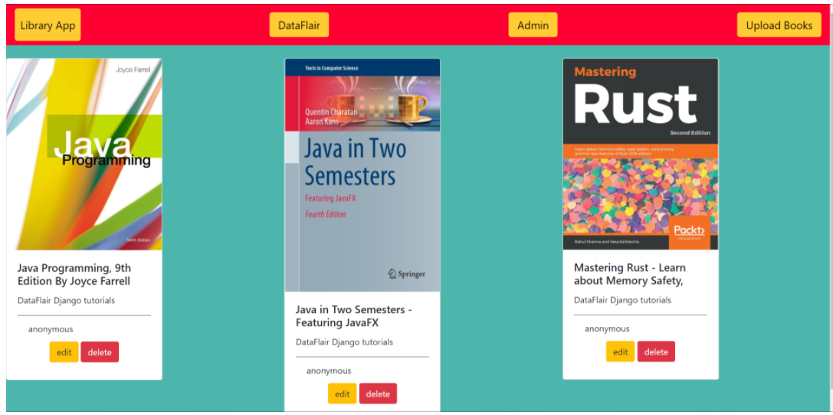

Slide 328
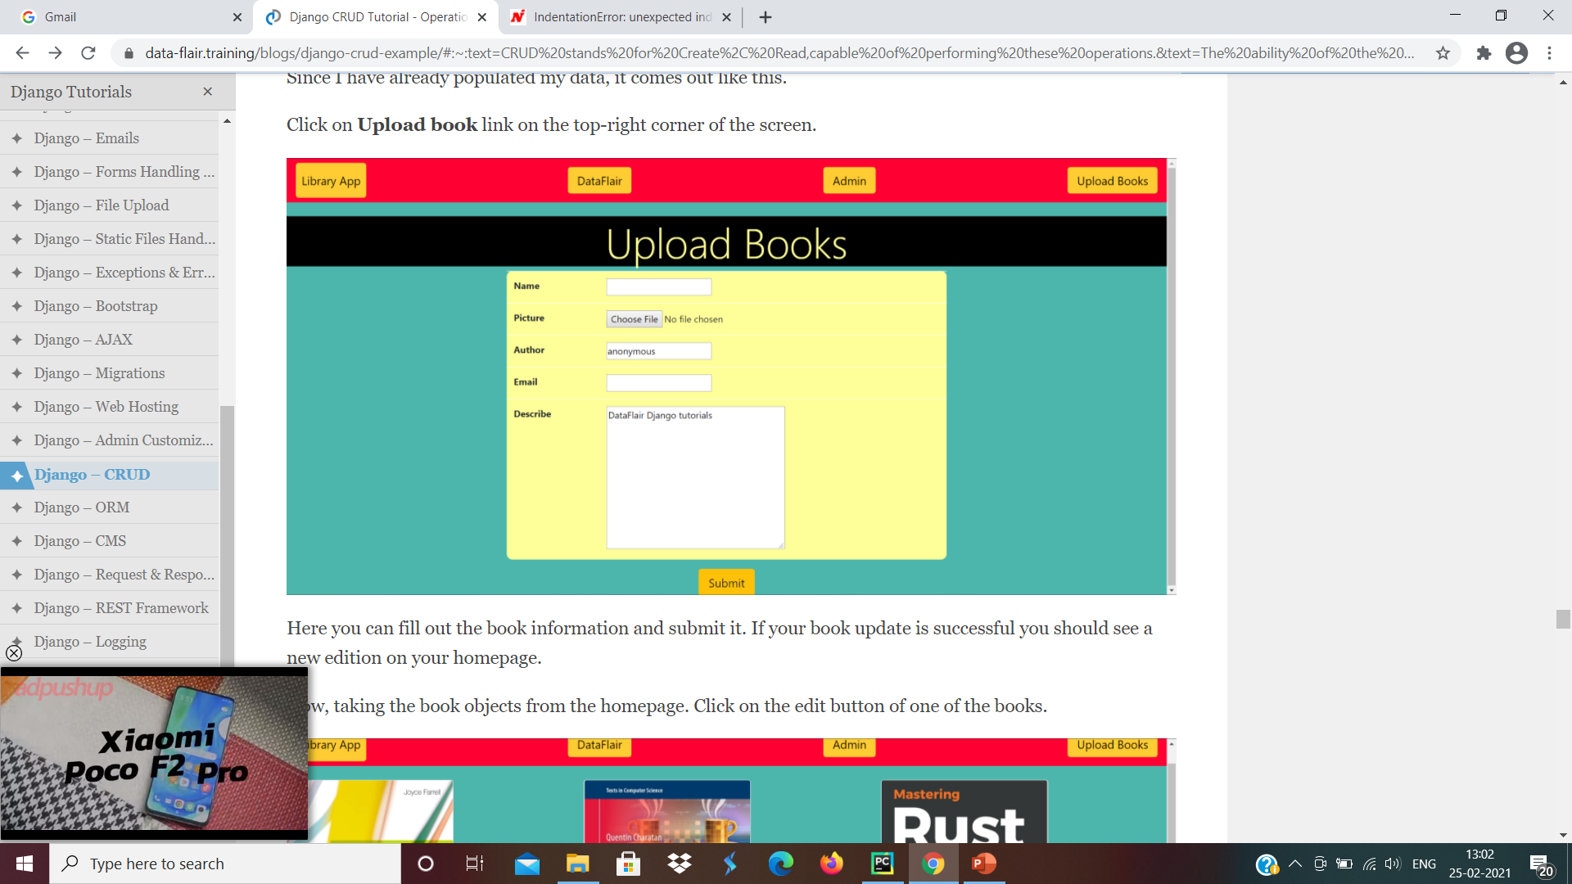
Here you can fill out the book information and submit it. If your book update is successful you should see a new edition on your homepage.

Slide 329
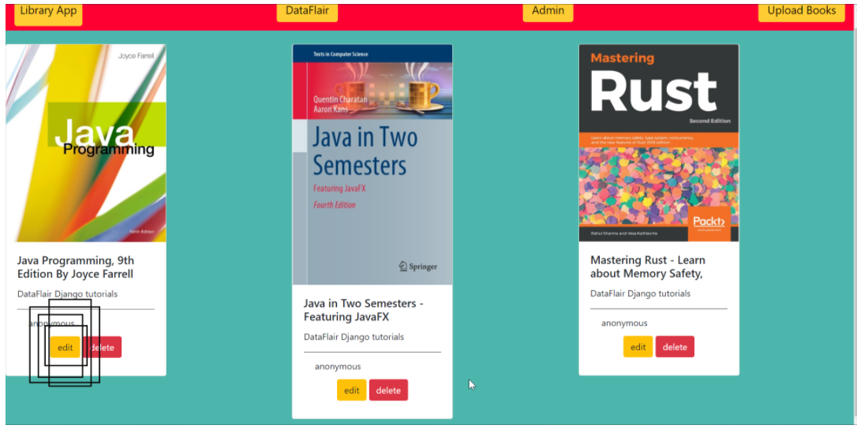
Now, taking the book objects from the homepage. Click on the edit button of one of the books

Slide 330
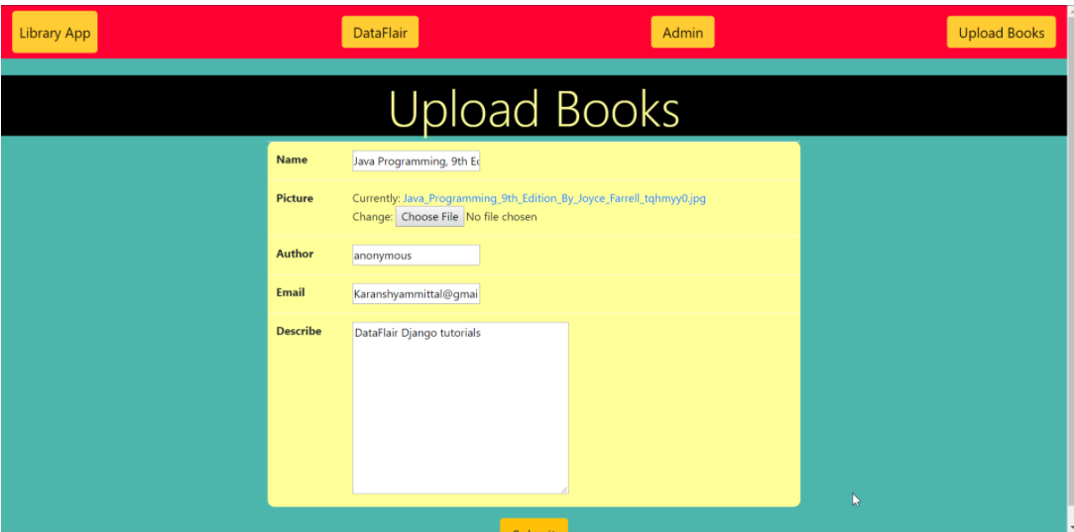
You can now change the information accordingly and submit again. This will change the data in the database.

Slide 331
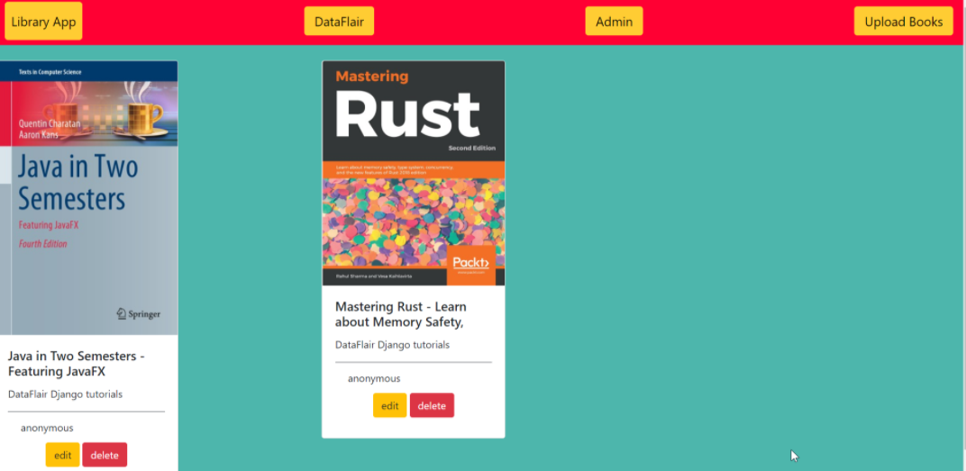
Lastly, when you click the delete button in a book object, the book will be deleted from the database.

Slide 332
python3 manage.py migrate
python3 manage.py runserver
Access to the Browser
Access the application by entering localhost:8000/show, it will show all the available employee records.

Slide 333
BOOTSTRAP

Slide 334
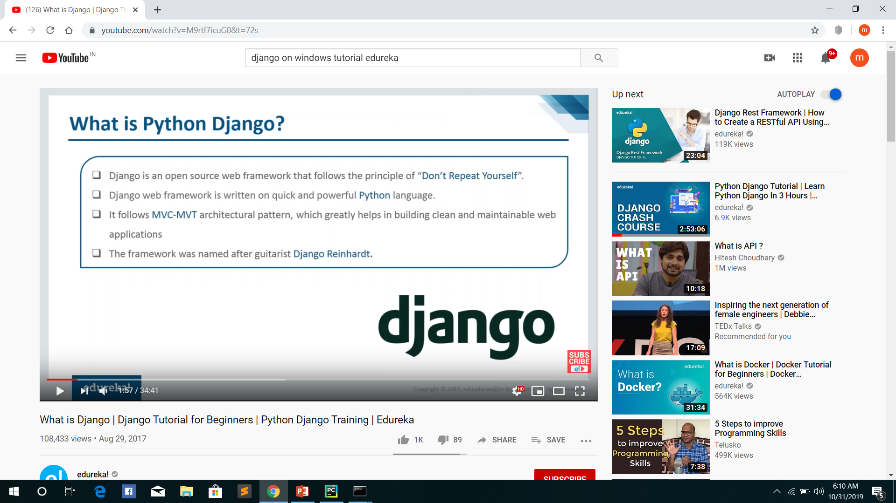

Slide 335
BOOTSTRAP
Bootstrap is completely free to download and use!
Bootstrap is a free front-end framework for faster and easier web development
Bootstrap is the most popular HTML, CSS, and JavaScript framework for developing responsive, mobile-first websites.

Slide 336
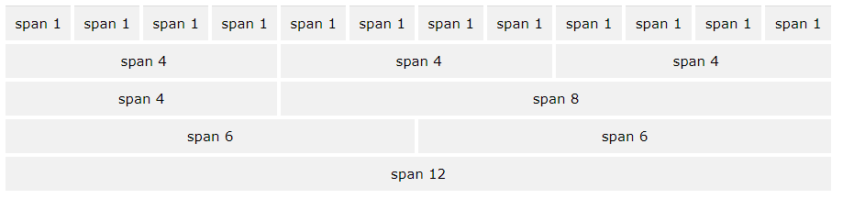
Bootstrap Grid System
Bootstrap's grid system allows up to 12 columns across the page.

Slide 337
Advantages of Bootstrap
Easy to use: Anybody with just basic knowledge of HTML and CSS can start using Bootstrap
Responsive features: Bootstrap's responsive CSS adjusts to phones, tablets, and desktops

Slide 338
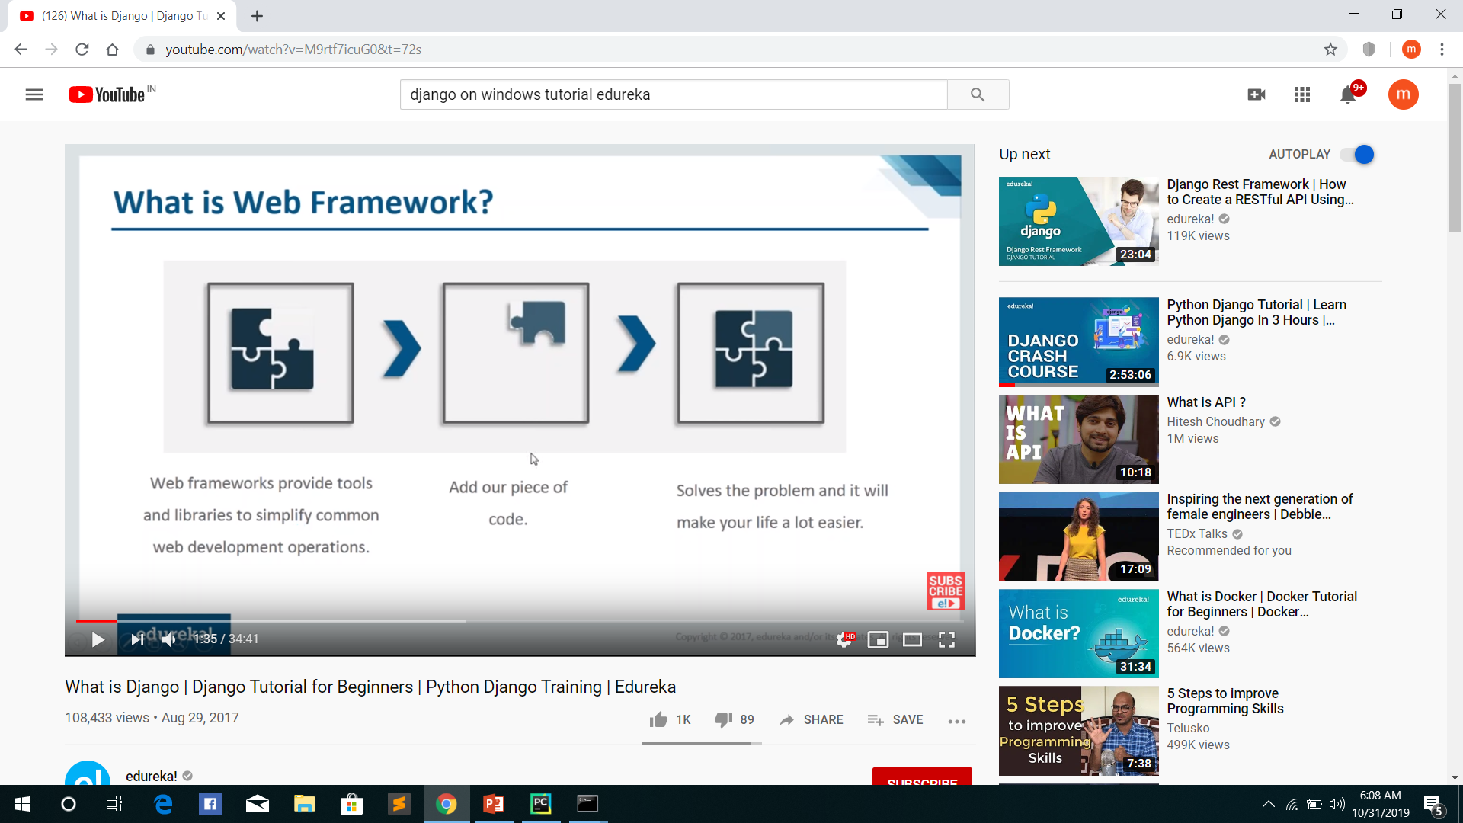

Slide 339
Grid Classes
The Bootstrap grid system has four classes:
xs (for phones - screens less than 768px wide)
sm (for tablets - screens equal to or greater than 768px wide)
md (for small laptops - screens equal to or greater than 992px wide)
lg (for laptops and desktops - screens equal to or greater than 1200px wide)

Slide 340
Button Style
Bootstrap provides different styles of buttons:
To achieve the button styles above, Bootstrap has the following classes:
.btn-basic
.btn-default
.btn-primary
.btn-success
.btn-info
.btn-warning
.btn-danger
.btn-link

Slide 341
example
<button type="button" class="btn-basic">Basic</button> <button type="button" class="btn-default">Default</button> <button type="button" class="btn-primary">Primary</button> <button type="button" class="btn-success">Success</button> <button type="button" class=“btn-info">Info</button> <button type="button" class="btn-warning">Warning</button> <button type="button" class="btn-danger">Danger</button> <button type="button" class="btn-link">Link</button>

Slide 342
JSON
JSON syntax is basically considered as a subset of JavaScript syntax; it includes the following −
• Data is represented in name/value pairs.
• Curly braces hold objects and each name is followed by ':'(colon), the name/value pairs are separated by , (comma).
• Square brackets hold arrays and values are separated by ,(comma).

Slide 343
JSON Functions
Function Libraries
encode Encodes the Python object into a JSON string representation.
decode Decodes a JSON-encoded string into a Python object.

Slide 344
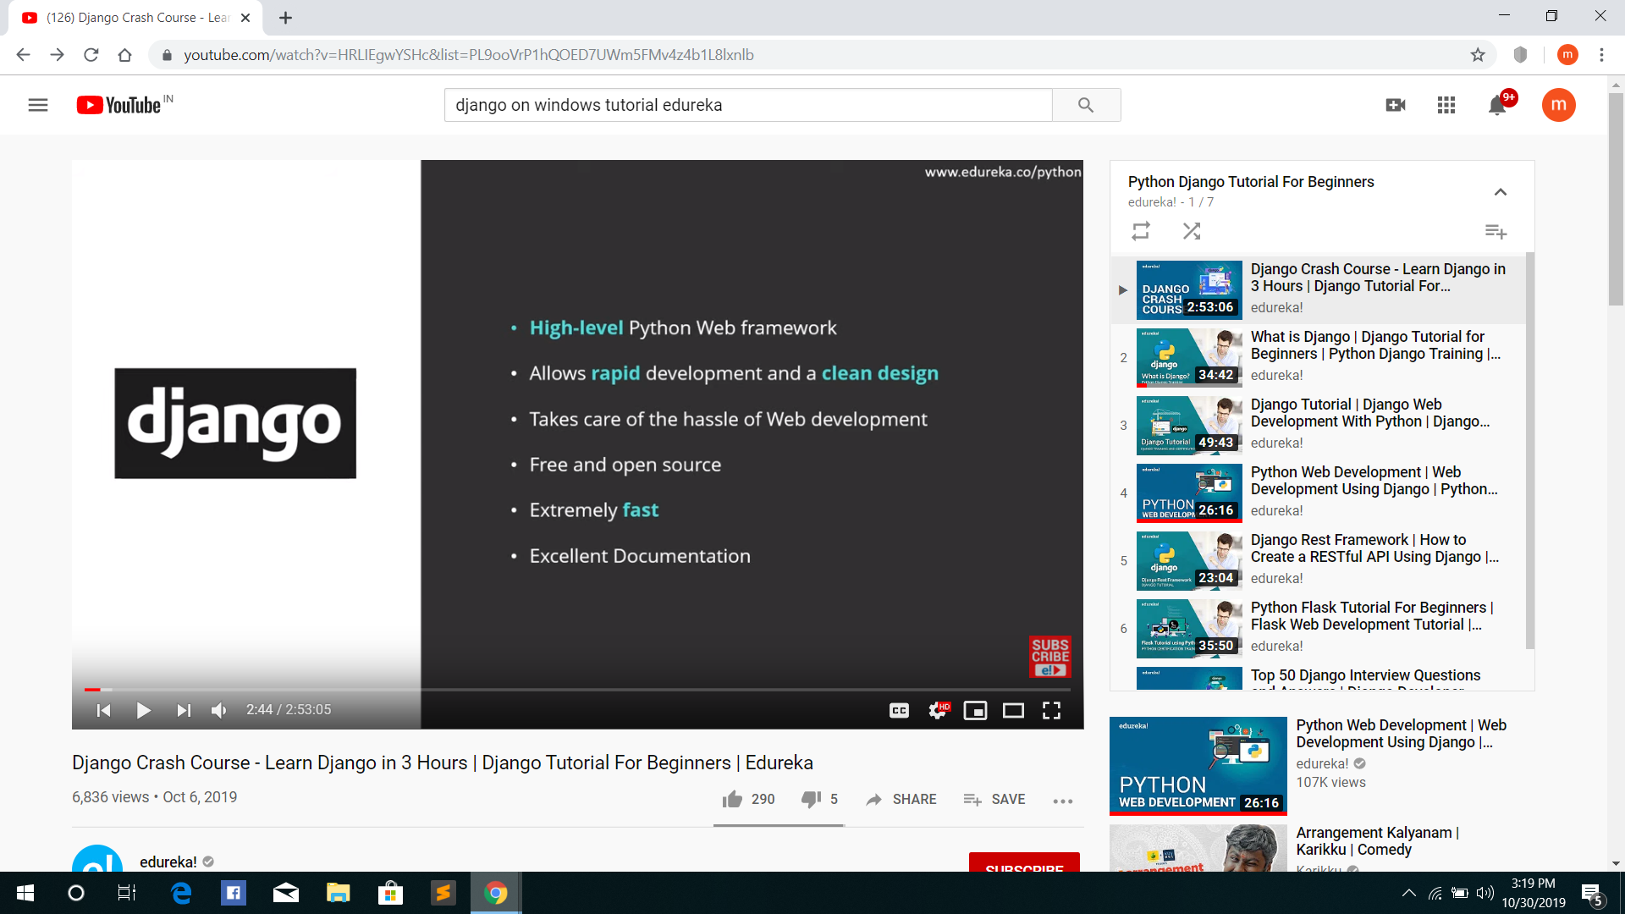

Slide 345
<p id="ab"></p>
<script>
var d={Name:'Megha',Age:20,Place:'EKM'}
var d1=JSON.stringify(d);
document.getElementById("ab").innerHTML=d1;
</script>

Slide 346
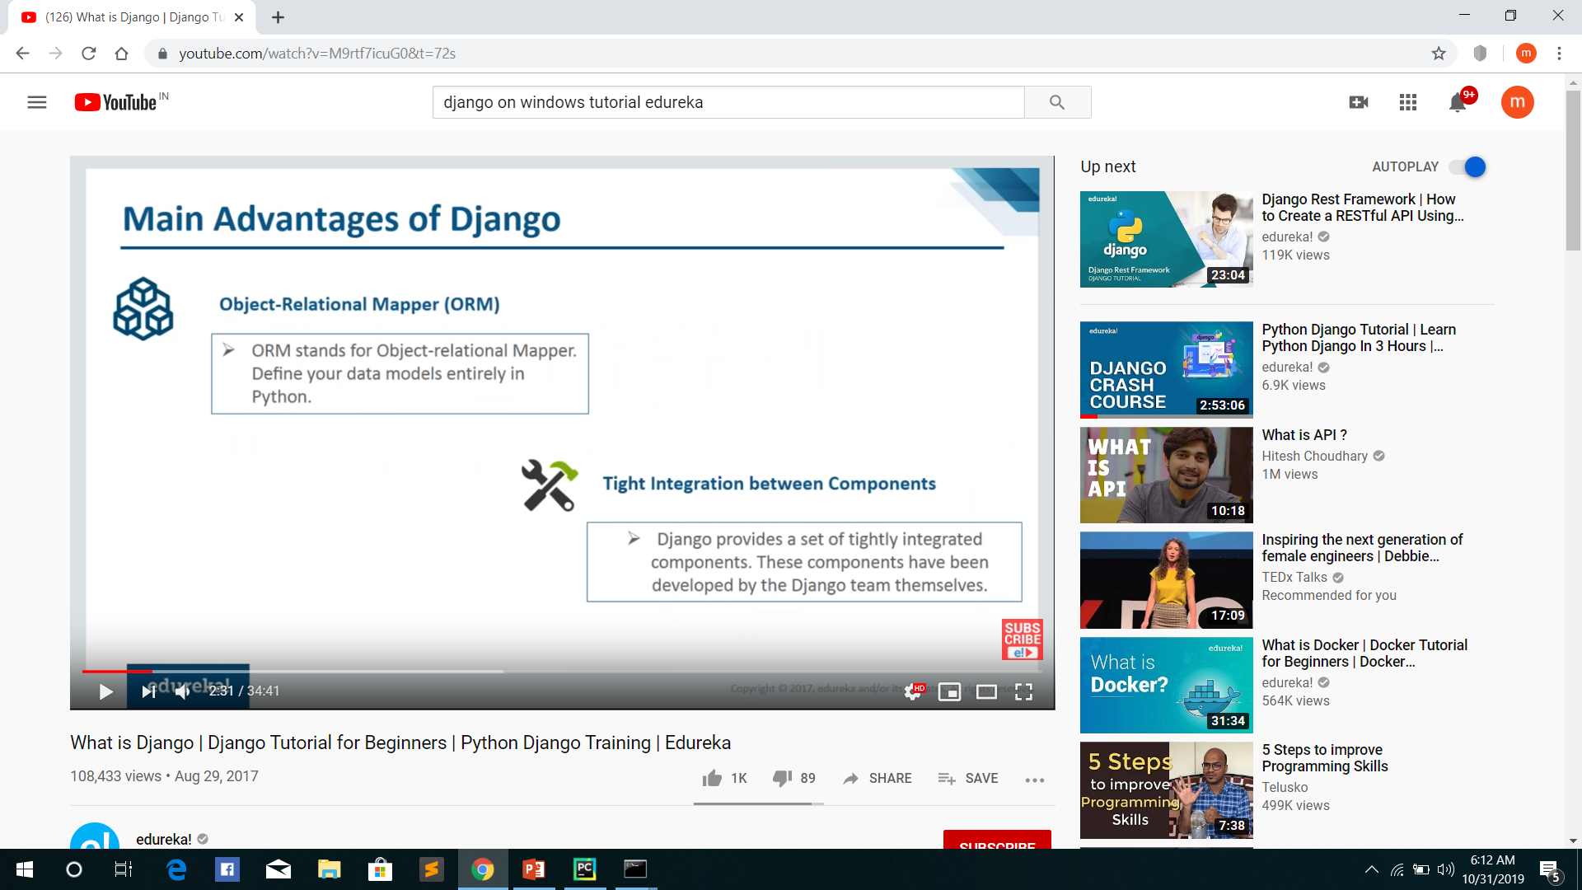

Slide 347
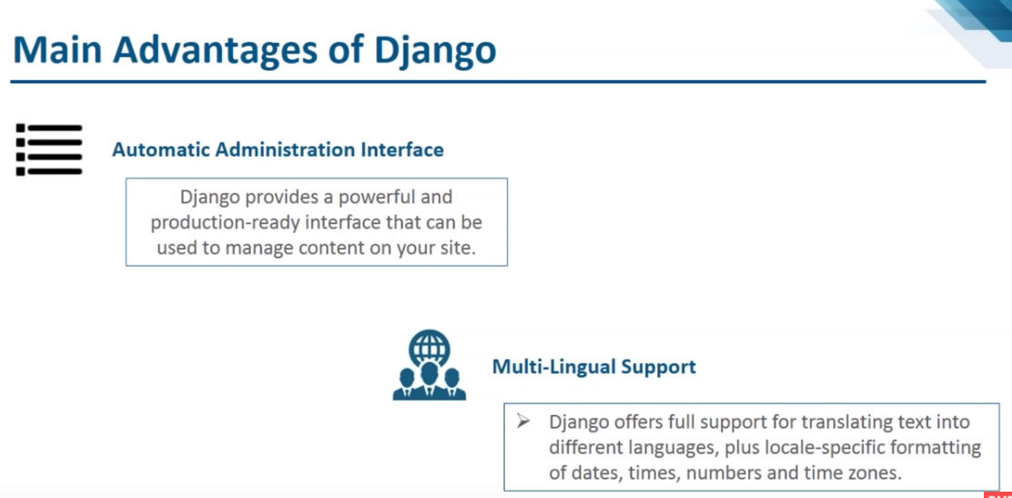

Slide 348
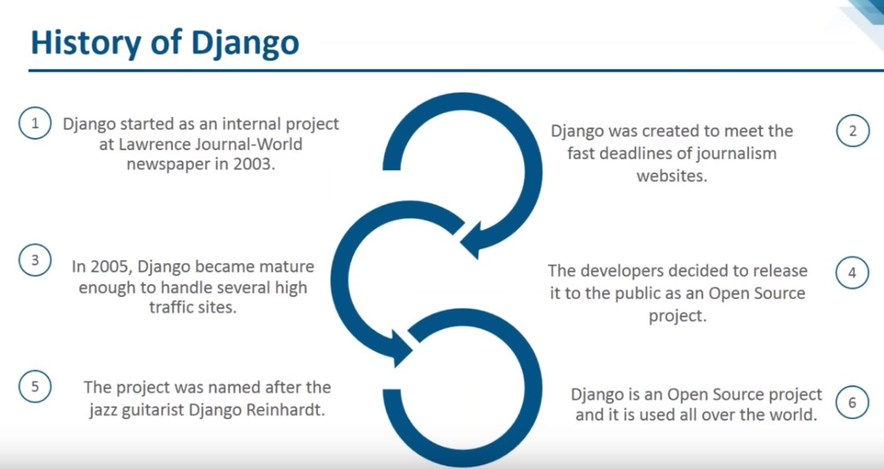

Slide 349
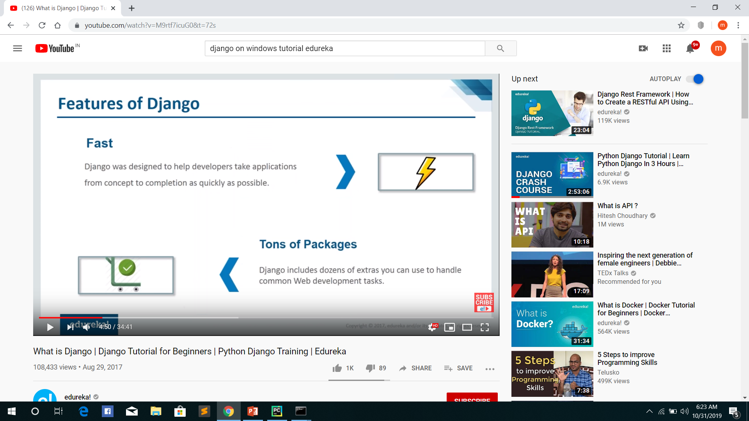

Slide 350
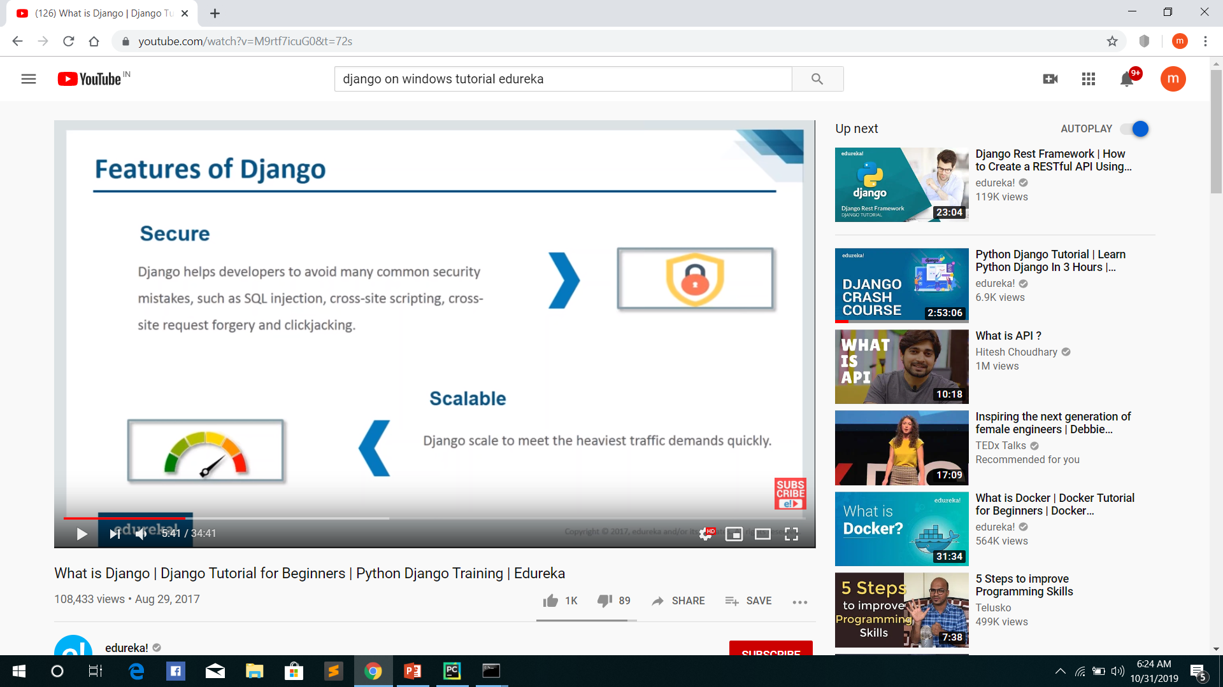

Slide 351
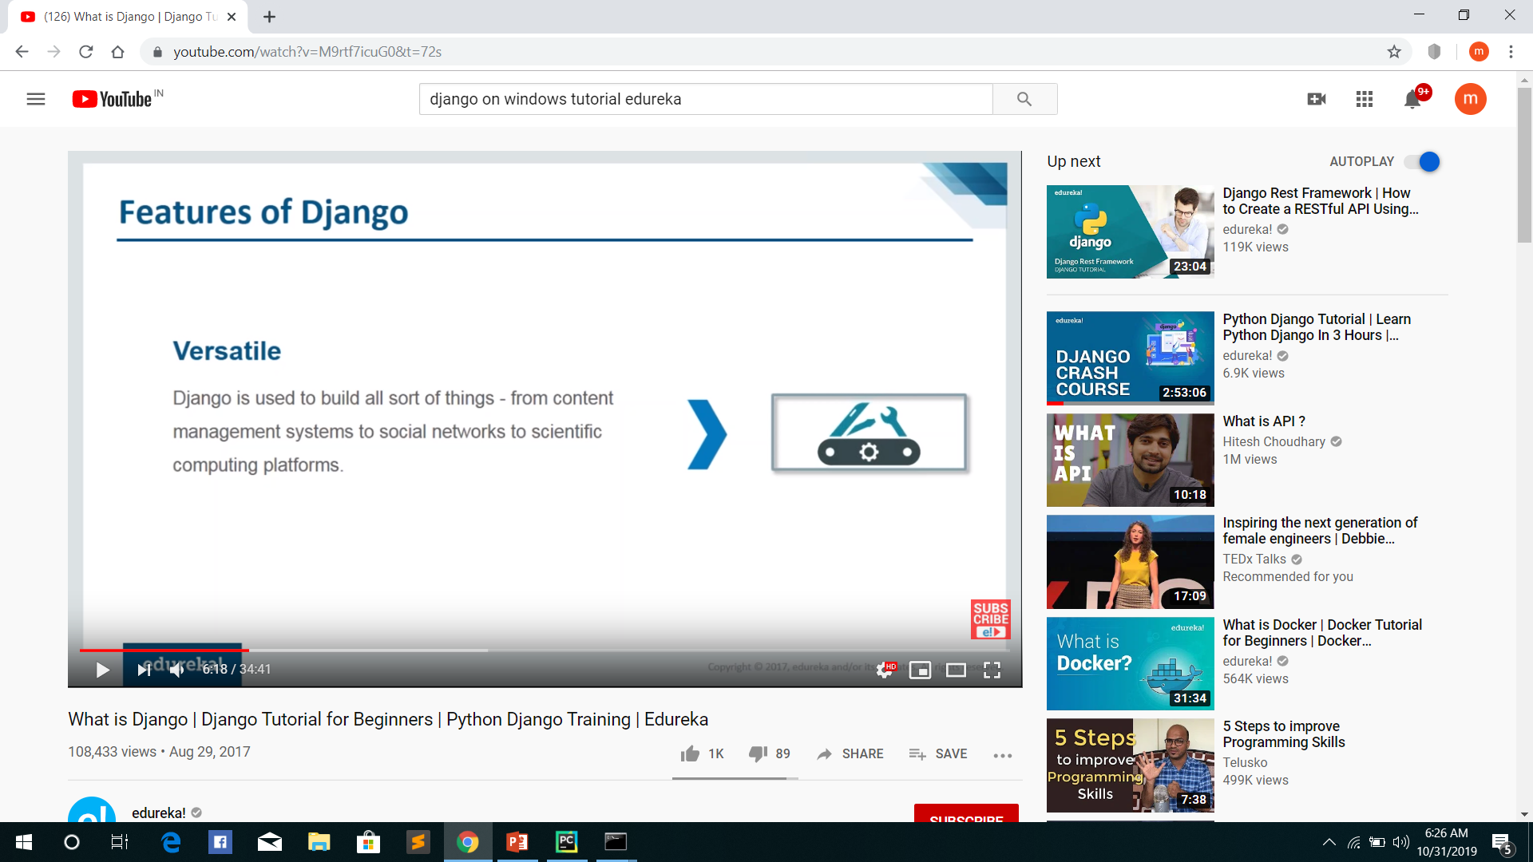

Slide 352
